Slide 1
Writing in the Content Areas and TELPAS
Cristina G. Vázquez, Manager, Language Accessibility and Proficiency Measurement
Dr. Justin Porter, Director, Assessments for Special Populations
Student Assessment Division, Texas Education Agency

Slide 2
Disclaimer
These slides have been prepared by the Student Assessment Division of the Texas Education Agency.
If any slide is amended or revised for local use, please remove the TEA footer at the bottom of the slide.

Slide 3
Session Objectives
To show close connection between ELPS and TELPAS for the domain of writing for grades 2–12
To reinforce benefits of incorporating ELPS for writing in content area instruction to teach and assess ELLs effectively throughout the year
To assist teachers to incorporate writing assignments during content area instruction so there is a smooth transition to gather writing samples for TELPAS

Slide 4
TELPAS Writing
Assessment Requirements for Grades 2–12

Slide 5
Grades 2–12 Writing
Assessment Approach
Raters assemble a collection of each student’s writing from a variety of content areas.
Raters base the English writing proficiency ratings on the contents of the collections.
Additional classroom observations are not used.

Slide 6
Assembly Criteria
Each writing collection must contain –
  At least 5 total samples
    At least 1 writing sample that elicits use of past tense
    At least 2 writing samples from mathematics, science, or social studies
Writing assigned on or after (February 15) may be considered for the collection and samples may continue to be gathered until the date designated by the district. This district deadline for completing writing collections must allow for collections to be verified and rated in order for ratings to be submitted by state established deadlines.

Slide 7
Some Eligible Types of Writing
Basic descriptive writing on a personal/familiar topic
Writing about a familiar process
Writing that elicits use of past tense
Personal narratives and reflective pieces
Expository and other extended writing on a topic from language arts
Expository or procedural writing from science, mathematics, and social studies

Slide 8
Writing Collections
TELPAS writing samples to include in the collections should be taken from authentic classroom activities grounded in content area TEKS and ELPS.
Collections should contain some papers in which students showcase English they know and feel comfortable using.
Collections should also include papers in which students are stretched and pushed beyond their comfort zone so the collection shows that a student has not yet reached the next level (the student is beginning but not yet intermediate, intermediate but not yet advanced, advanced but not yet advanced high).

Slide 9
Writing Collections
Collections assembled need to help raters determine and justify ratings. The samples in a collection must give you evidence to say, “I know the student is at least at X proficiency level because of these characteristics in his or her writing. I know the student is not yet at the next proficiency level because of these other characteristics in his or her writing.”
Reminder: The characteristics considered must come from the PLDs.

Slide 10
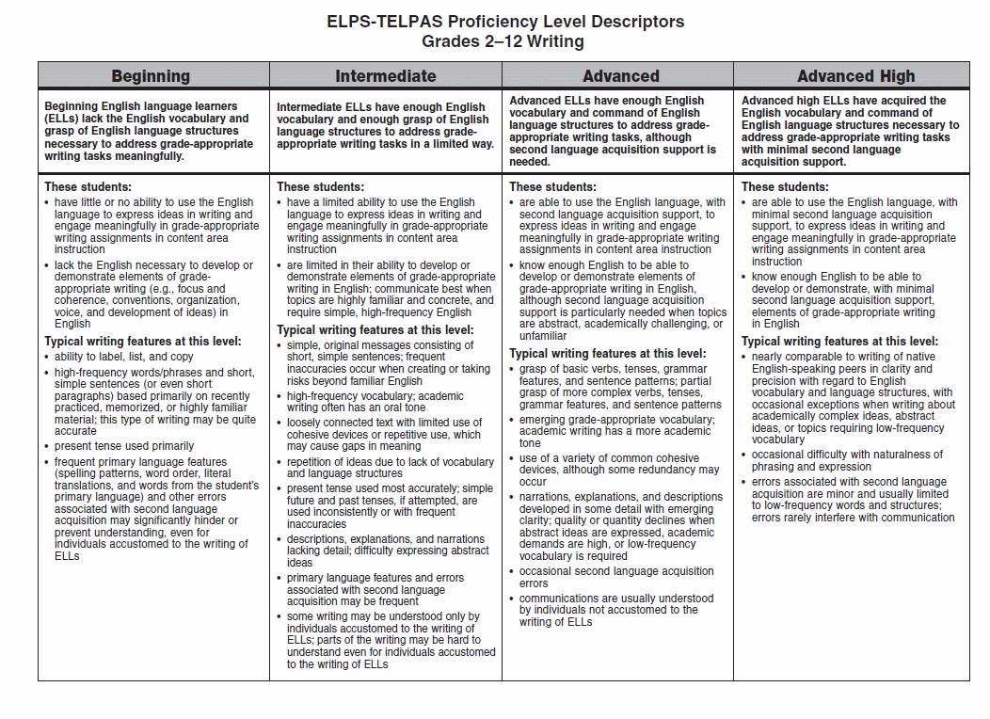

Slide 11
Goal in Assembling Writing Collections
To make sure the collections portray the students’ overall English writing proficiency levels

Slide 12
ELPS for Writing

Slide 13
ELPS Components
a) Introduction Integrate second language instruction with content area instruction to make content comprehensible build academic language proficiency | c) Student Expectations for Second Language Acquisition Learning Strategies Listening Speaking Reading Writing
b) District Responsibilities Linguistically adjust instruction based on student proficiency levels Implement strategic interventions for beginning and intermediate students in grade 3 and up | d) Proficiency Level Descriptors for each Language Domain Beginning Intermediate Advanced Advanced High

Slide 14
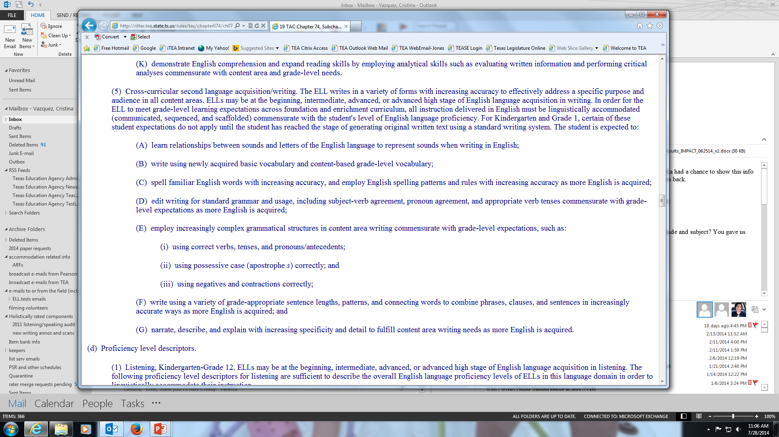
ELPS Student Expectations for Second Language Acquisition for Writing

Slide 15
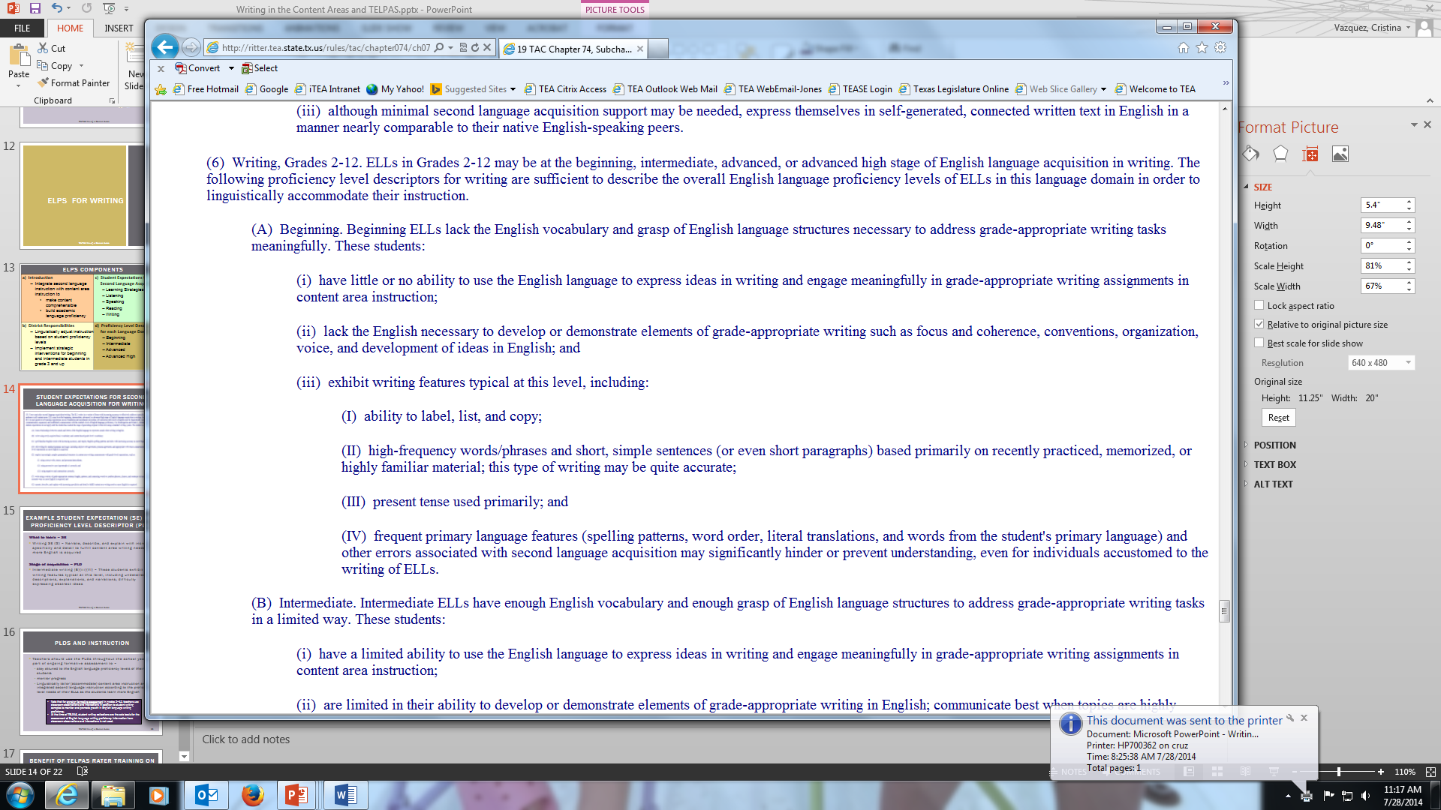
ELPS Proficiency Level Descriptors for Grades 2–12 Writing

Slide 16
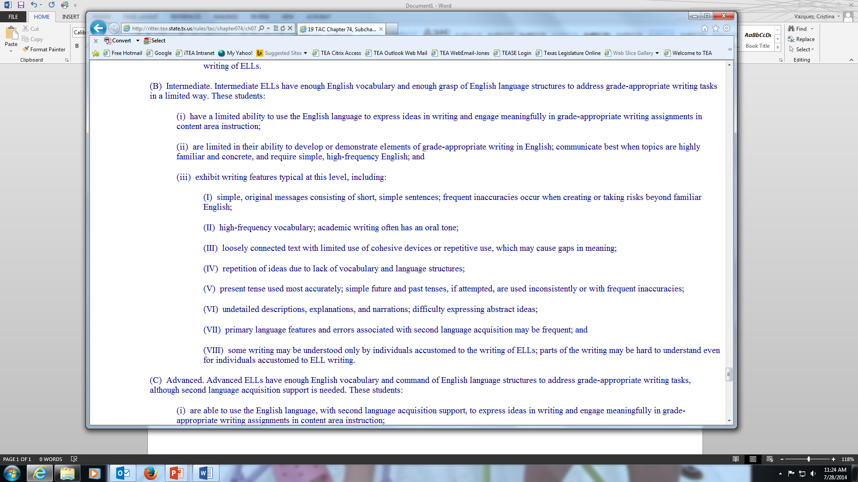
ELPS Proficiency Level Descriptors for Grades 2–12 Writing

Slide 17
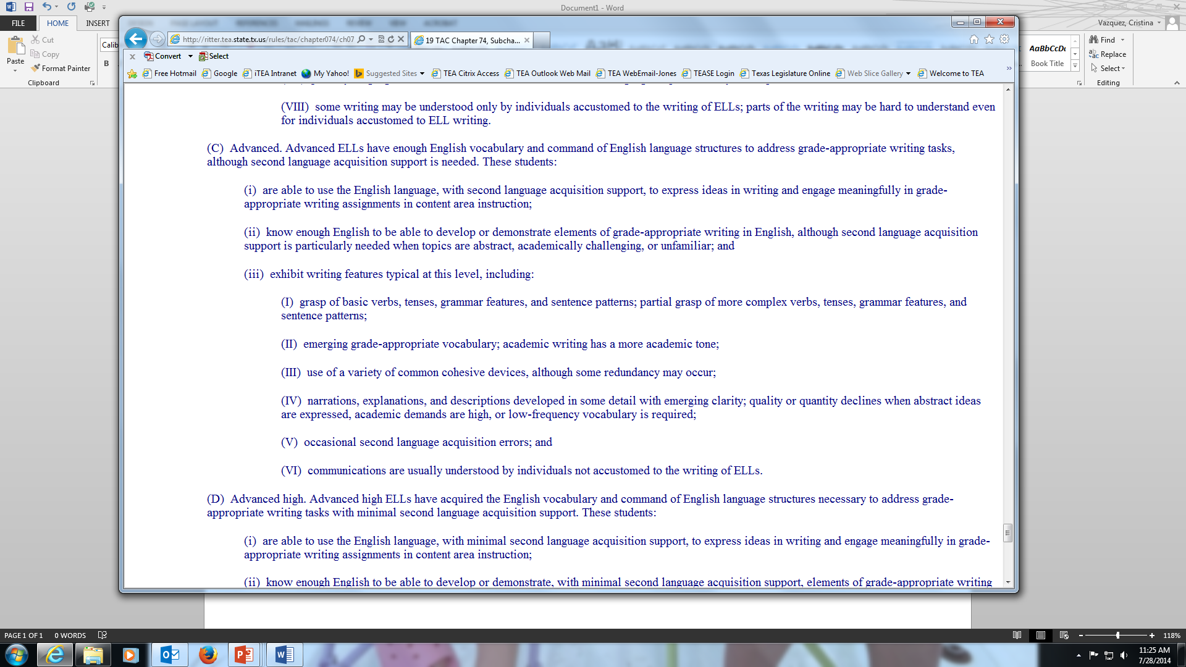
ELPS Proficiency Level Descriptors for Grades 2–12 Writing

Slide 18
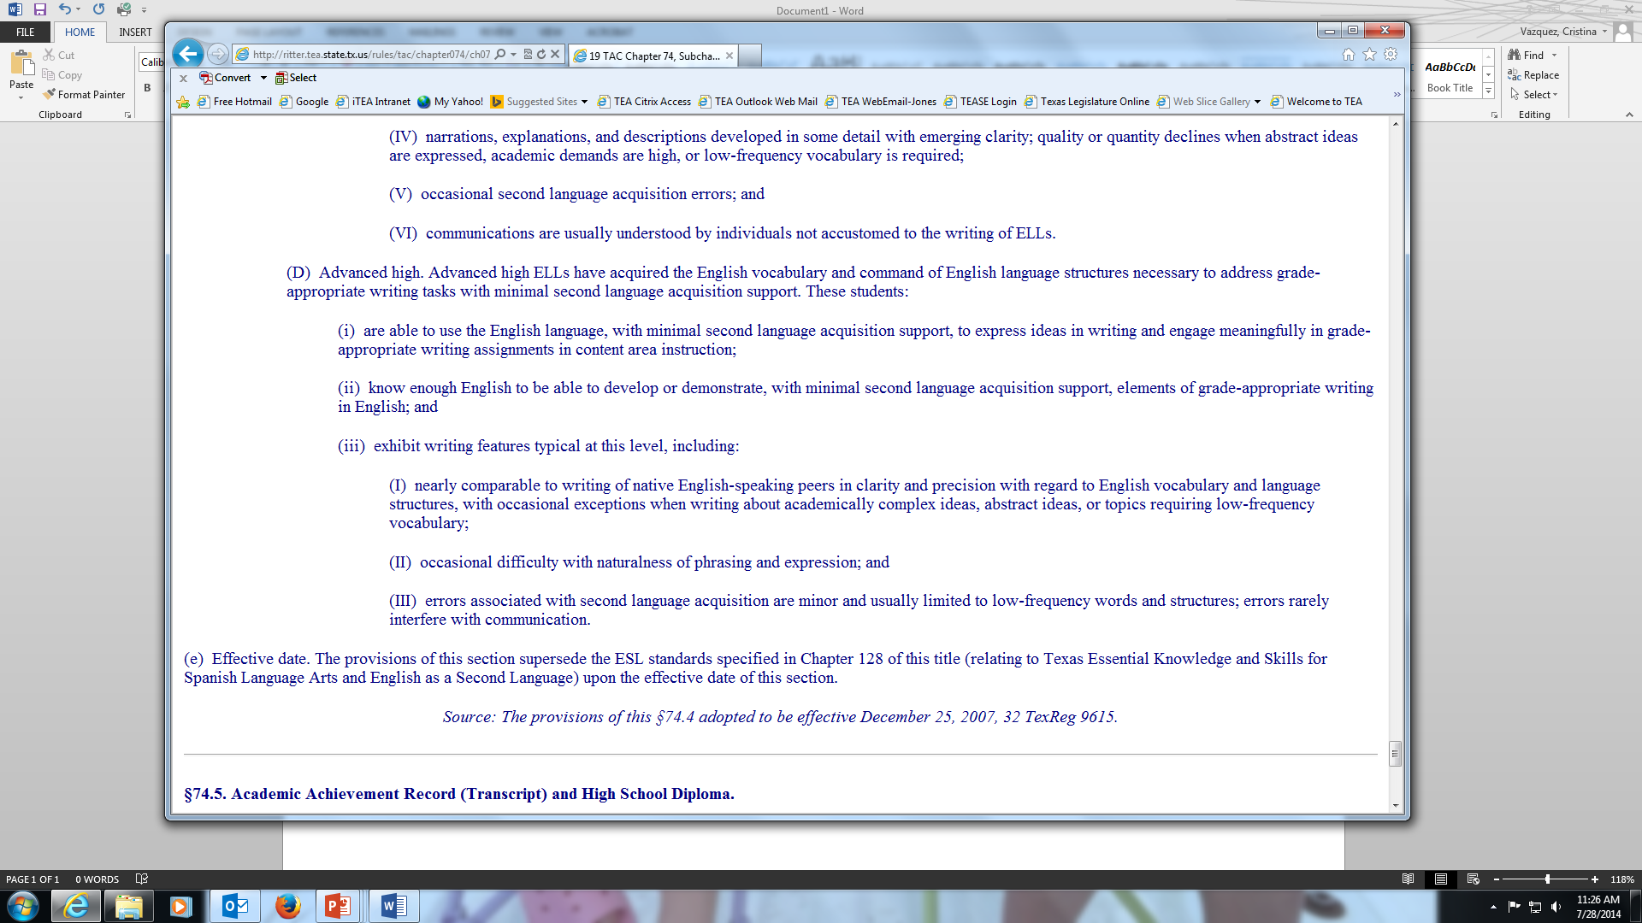
ELPS Proficiency Level Descriptors for Grades 2–12 Writing

Slide 19
Example Student Expectation (SE) and Proficiency Level Descriptor (PLD)
What to learn – SE
Writing SE (G) – Narrate, describe, and explain with increasing specificity and detail to fulfill content area writing needs as more English is acquired
Stage of acquisition – PLD
Intermediate writing (B)(iii)(VI) – These students exhibit writing features typical at this level, including undetailed descriptions, explanations, and narrations; difficulty expressing abstract ideas

Slide 20
PLDs and Instruction
Teachers should use the PLDs throughout the school year as part of ongoing formative assessment to –
  stay attuned to the English language proficiency levels of their students,
  monitor progress, and
  linguistically tailor (accommodate) content area instruction and integrate second language instruction according to the proficiency level needs of their ELLs as the students learn more English.

Slide 21
PLDs and Instruction
  Note that for ongoing formative assessment in grades 2–12, teachers use classroom observations and interactions in addition to student writing samples to monitor and promote growth in English language writing proficiency.
  At the time of TELPAS, student writing collections are the sole basis for the assessment of English language writing proficiency. Information from classroom observations and interactions is not used.

Slide 22
Benefit of TELPAS Rater Training on Formative Classroom Assessment
Teachers trained as TELPAS raters internalize the PLDs so that they are able to naturally and automatically assess their students’ English language proficiency levels during ongoing classroom instruction.

Slide 23
Benefit of Using PLDs in Instruction
Teachers learn to make effective linguistic accommodations in class, which supports
  learning of academic subject matter (TEKS content area SEs)
  learning of English language (ELPS SEs)

Slide 24
Measuring the ELPS
TELPAS assesses the abilities outlined in the
ELPS student expectations (SEs)
and reports performance in alignment with the
ELPS proficiency level descriptors (PLDs).
TELPAS measures the ELPS; the two are integrally aligned.

Slide 25
Writing in the Content Areas
Mathematics

Slide 26
Elementary Example
TEKS 3 (4) Number and operations.
The student applies mathematical process standards to develop and use strategies and methods for whole number computations in order to solve problems with efficiency and accuracy. The student is expected to: (G) use strategies and algorithms, including the standard algorithm, to multiply a two-digit number by a one-digit number. Strategies may include mental math, partial products, and the commutative, associative, and distributive properties.
Example Writing Assignment:
Solve the problem and explain the strategy you used to get your answer.
There were 8 classmates who were planting flowers when 3 more students joined to help. If each student plants 4 flowers, how many flowers did they plant total?

Slide 27
Elementary Example
ELPS
5(B) write using newly acquired basic vocabulary and content-based grade-level vocabulary
5(F) write using a variety of grade-appropriate sentence lengths, patterns, and connecting words to combine phrases, clauses, and sentences in increasingly accurate ways as more English is acquired
5(G) narrate, describe, and explain with increasing specificity and detail to fulfill content area writing needs as more English is acquired

Slide 28
Middle School Example
TEKS 6 (2) Number and operations.
The student applies mathematical process standards to represent and use rational numbers in a variety of forms. The student is expected to: (D) order a set of rational numbers arising from mathematical and real-world contexts.
Example Writing Assignment:
Solve the problem and explain the steps taken.
There are four students working on a project in math class. Miguel has completed 1/8 of the project, Gina has completed 13% of the project, Jatziry has completed 0.10 of the project, and Kwa has completed 1/9 of the project. Make a list of the students in order from least to greatest by the amount of the project they have completed.

Slide 29
Middle School Example
ELPS
5(B) write using newly acquired basic vocabulary and content-based grade-level vocabulary
5(F) write using a variety of grade-appropriate sentence lengths, patterns, and connecting words to combine phrases, clauses, and sentences in increasingly accurate ways as more English is acquired
5(G) narrate, describe, and explain with increasing specificity and detail to fulfill content area writing needs as more English is acquired

Slide 30
High School Example
TEKS Geometry (8) Congruence and the geometry of size.
The student uses tools to determine measurements of geometric figures and extends measurement concepts to find perimeter, area, and volume in problem situations. The student is expected to: (D) find surface areas and volumes of prisms, pyramids, spheres, cones, cylinders, and composites of these figures in problem situations.
Example Writing Assignment:
Solve the problem and explain the steps taken.
Three basketballs are being painted for the Junior Class Silent Auction Fundraiser. If the diameter of each basketball is 11 inches, what is the total surface area that will be painted?

Slide 31
High School Example
ELPS
5(B) write using newly acquired basic vocabulary and content-based grade-level vocabulary
5(F) write using a variety of grade-appropriate sentence lengths, patterns, and connecting words to combine phrases, clauses, and sentences in increasingly accurate ways as more English is acquired
5(G) narrate, describe, and explain with increasing specificity and detail to fulfill content area writing needs as more English is acquired

Slide 32
Writing in the Content Areas
Science

Slide 33
Elementary Example
TEKS 4 (10) Organisms and environments.
The student knows that organisms undergo similar life processes and have structures that help them survive within their environment. The student is expected to: (B) demonstrate that some likenesses between parents and offspring are inherited, passed from generation to generation such as eye color in humans or shapes of leaves in plants. Other likenesses are learned such as table manners or reading a book and seals balancing balls on their noses.
Example Writing Assignment:
Explain the difference between inherited and learned likenesses. Give 3 examples of inherited likenesses and 3 examples of learned likenesses you received from your parents.

Slide 34
Elementary Example
ELPS
5(B) write using newly acquired basic vocabulary and content-based grade-level vocabulary
5(E) employ increasingly complex grammatical structures in content area writing commensurate with grade-level expectations, such as:
  (ii) using possessive case (apostrophe s) correctly
5(G) narrate, describe, and explain with increasing specificity and detail to fulfill content area writing needs as more English is acquired

Slide 35
Middle School Example
TEKS 7 (8) Earth and space.
The student knows that natural events and human activity can impact Earth systems. The student is expected to: (A) predict and describe how different types of catastrophic events impact ecosystems such as floods, hurricanes, or tornadoes.
Example Writing Assignment:
Describe 3 types of catastrophic events and how they can impact an ecosystem.

Slide 36
Middle School Example
ELPS
5(B) write using newly acquired basic vocabulary and content-based grade-level vocabulary
5(F) write using a variety of grade-appropriate sentence lengths, patterns, and connecting words to combine phrases, clauses, and sentences in increasingly accurate ways as more English is acquired
5(G) narrate, describe, and explain with increasing specificity and detail to fulfill content area writing needs as more English is acquired

Slide 37
High School Example
TEKS Biology (6) Science concepts.
The student knows the mechanisms of genetics, including the role of nucleic acids and the principles of Mendelian Genetics. The student is expected to: (F) predict possible outcomes of various genetic combinations such as monohybrid crosses, dihybrid crosses and non-Mendelian inheritance.
Example Writing Assignment:
A pea plant with the genotype Tt for tall stems is crossed with a pea plant with the same genotype Tt. Draw and complete a Punnett square of the parent genotypes then explain and describe all the possible genotypes and phenotypes of the offspring.

Slide 38
High School Example
ELPS
5(B) write using newly acquired basic vocabulary and content-based grade-level vocabulary
5(E) employ increasingly complex grammatical structures in content area writing commensurate with grade-level expectations, such as:
  (i) using correct verbs, tenses, and pronouns/antecedents
5(F) write using a variety of grade-appropriate sentence lengths, patterns, and connecting words to combine phrases, clauses, and sentences in increasingly accurate ways as more English is acquired
5(G) narrate, describe, and explain with increasing specificity and detail to fulfill content area writing needs as more English is acquired

Slide 39
Writing in the Content Areas
Social Studies

Slide 40
Elementary Example
TEKS 5 (15) Government.
The student understands important ideas in the Declaration of Independence, the U.S. Constitution, and the Bill of Rights. The student is expected to: (C) explain the reasons for the creation of the Bill of Rights and its importance.
Example Writing Assignment:
Explain why the Bill of Rights was created and why it is important.

Slide 41
Elementary Example
ELPS
5(B) write using newly acquired basic vocabulary and content-based grade-level vocabulary
5(F) write using a variety of grade-appropriate sentence lengths, patterns, and connecting words to combine phrases, clauses, and sentences in increasingly accurate ways as more English is acquired
5(G) narrate, describe, and explain with increasing specificity and detail to fulfill content area writing needs as more English is acquired

Slide 42
Middle School Example
TEKS 6 (5) Geography.
The student understands how geographic factors influence the economic development, political relationships, and policies of societies. The student is expected to: (A) identify and explain the geographic factors responsible for the location of economic activities in places and regions.
Example Writing Assignment:
Describe how geographic factors have affected the economy of 3 different regions around the world.

Slide 43
Middle School Example
ELPS
5(B) write using newly acquired basic vocabulary and content-based grade-level vocabulary
5(E) employ increasingly complex grammatical structures in content area writing commensurate with grade-level expectations, such as:
  (i) using correct verbs, tenses, and pronouns/antecedents
5(F) write using a variety of grade-appropriate sentence lengths, patterns, and connecting words to combine phrases, clauses, and sentences in increasingly accurate ways as more English is acquired
5(G) narrate, describe, and explain with increasing specificity and detail to fulfill content area writing needs as more English is acquired

Slide 44
High School Example
TEKS World History (3) History.
The student understands the contributions and influence of classical civilizations from 500 BC to AD 600 on subsequent civilizations. The student is expected to: (B) explain the impact of the fall of Rome on Western Europe.
Example Writing Assignment:
How did the fall of Rome impact Western Europe?

Slide 45
High School Example
ELPS
5(B) write using newly acquired basic vocabulary and content-based grade-level vocabulary
5(E) employ increasingly complex grammatical structures in content area writing commensurate with grade-level expectations, such as:
  (i) using correct verbs, tenses, and pronouns/antecedents
  (ii) using possessive case (apostrophe s) correctly
5(F) write using a variety of grade-appropriate sentence lengths, patterns, and connecting words to combine phrases, clauses, and sentences in increasingly accurate ways as more English is acquired
5(G) narrate, describe, and explain with increasing specificity and detail to fulfill content area writing needs as more English is acquired

Slide 46
Assembling Writing Collections for TELPAS

Slide 47
Samples Required
At least 5 total samples are required in each collection.
In each collection there must be
  at least 1 writing sample that elicits use of past tense
  at least 2 writing samples from mathematics, science, or social studies
In all writing assignments, students should take their time and write in as much detail as they can.
Include writing assignments that allow students to show what they can do, as well as what students struggle with in second language acquisition to see the full extent of their language abilities.
Remember to build collections that portray the student’s overall ability to communicate in writing in English; avoid including samples in the writing collection that interfere with the ability to rate students effectively.

Slide 48
Types of Writing
Basic descriptive writing on a personal/familiar topic
Examples:
  Writing about yourself, your family, your best friend, your school, etc.
  Describing what you see in this picture, photo, piece of art, etc.
  Comparing yourself to a friend or relative by describing how you are alike and how you are different
  Comparing two friends, two pictures, two photos, two places you’ve lived or houses you’ve lived in, etc.

Slide 49
Types of Writing
Writing about a familiar process
Examples:
  A daily routine (getting ready for school, what you do after school or on weekends)
  How to prepare a familiar food or recipe (sandwich, taco, fruit drink, scrambled eggs)
  How to play a familiar game or sport

Slide 50
Types of Writing
Writing that elicits use of past tense
Examples:
  Stories based on something shown in a picture or pictures
  Narratives about something that happened or that you did that was disappointing, unforgettable, surprising, interesting, unexpected, funny, unfair, etc.
  Original stories composed in creative writing activities
  Narratives about what you did this morning, yesterday, last weekend
  Explanation of mathematical concept, scientific process, or historical figure you have learned about

Slide 51
Types of Writing
Personal narratives and reflective pieces
Examples:
  A time when you learned a lesson, resolved a problem with another person, etc.
  What true friendship is, the importance of believing in yourself, setting goals, etc.
  What you like, don’t like, or would like to see changed about certain school rules or policies
  A person you admire, a person who has influenced your life, etc.
  How first impressions of people can change
  What it was like to move to the United States, learn a new language, etc.
  What you thought about the United States or Texas before you moved here compared to what you think now

Slide 52
Types of Writing
Expository and other extended writing on a topic from language arts
Examples:
  Writing reflective pieces linked to stories, literature, poems, and drama read in class (for example, comparing events in a text with personal experiences; relating a character’s conflict in a text to a personal experience, experience of a friend, or experience of a relative; etc.)
  Describing and analyzing a change that a character undergoes
  Comparing story variants, a movie and novel based on the same story, etc.
  Writing persuasively to influence an audience to take action on an issue
  Writing responses to literary or expository texts and providing text evidence to demonstrate understanding

Slide 53
Types of Writing
Expository or procedural writing from science
Examples:
  Explaining a scientific process you have learned about
  Explaining the steps in an experiment or scientific investigation you have done
  Writing about something you are learning in your science class
  Writing about why lab rules are important
  Writing about how to use a certain device or piece of science equipment

Slide 54
Types of Writing
Expository or procedural writing from mathematics
Examples:
  Writing about a way you have used mathematics outside of school
  Explaining the steps you use in a mathematical process
  Writing about something you are learning in your mathematics class
  Writing to reflect the thinking you do to solve a problem

Slide 55
Types of Writing
Expository or procedural writing from social studies
Examples:
  Writing about a historical figure, the person’s contributions or significance, etc.
  Writing an expository piece about an important historical or current event
  Writing about something you are learning in your social studies class
  Defending a point of view about a governmental policy or controversial issue
  Writing a persuasive piece to influence a change in policy or law

Slide 56


Summing it Up
Writing in the content areas is not only required as part of the ELPS but an integral part of well-rounded classroom instruction.

Slide 57
Contact Information
Call Student Assessment Division at 512-463-9536
Send email to ELL Assessments team at ell.tests@tea.texas.gov
Information on State Assessments for English Language Learners http://tea.texas.gov/student.assessment/ell/

