Slide 1
Special Administration Request Form Training 2021-2022

Slide 2
Special Administration Request Form
This guidance document is intended to assist district staff on how to submit a request for a special administration of an online assessment for STAAR with Embedded Supports, STAAR Spanish with Embedded Supports, TELPAS reading, and TELPAS listening and speaking. Screen shots are provided along with specific information about each step in the process.
Special Administration Requests should be submitted for each individual student. A separate request form will need to be submitted for each testing program. For example, if a student needs a TELPAS paper reading test and a STAAR with Embedded Supports paper reading test, the district will submit two request forms, one for TELPAS and one for STAAR with Embedded Supports.
Requests for multiple students, such as those at a JJAEP, will be made through the Texas Support Center. The slides on the following pages will show how to complete this type of request.
Before requesting a special administration, review the accessibility features and designated supports sections of the Accommodation Resources webpage to ensure that the student wouldn’t be able to test with one or more of these supports.
A Special Administration Request Decision Making Flowchart is available to help guide districts in determining whether a special administration of an online assessment is appropriate for a particular situation.
Special Administration request approvals expire June 30th following the completion of the current academic school year.
Requests that contain CONFIDENTIAL STUDENT INFORMATION will be deleted and will not be processed.

Slide 3
Special Administration Request Form
The Special Administration Request Form is found in the Test Information Delivery System, TIDE. In the section titled Administration and Security Forms, select Submit a Form.

Slide 4
Special Administration Request Form
From the Submit a Form screen, select Accommodation Request from the drop-down menu.
On the form, make sure the Region, District, and Campus is filled in.

Slide 5
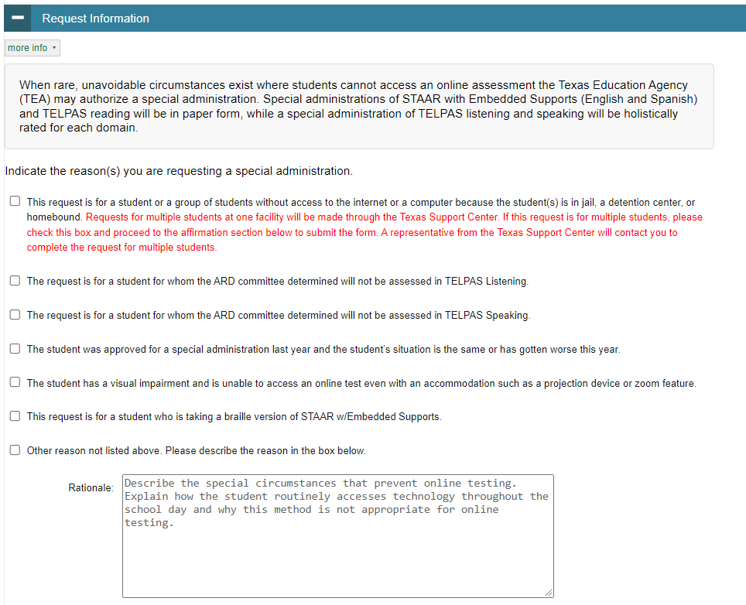
Special Administration Request Form
In the Request Information section, select a reason for requesting a special administration.

Slide 6
Special Administration Request Form
If the request is for multiple students without access to the internet, select the first checkbox and proceed to the affirmation section to submit the form. A representative from the Texas Support Center will contact you to complete the request for multiple students.

Slide 7
Special Administration Request Form
For students who are admission, review, and dismissal (ARD)-exempt in one domain of the TELPAS listening and speaking assessment, districts may request a special administration.
When submitting the Special Administration Request form, use the checkboxes to indicate the domain for which the student will not test.
Only one of these boxes should be checked for an individual student.

Slide 8
Special Administration Request Form
If the request is for a student who was approved for a special administration in a previous year, use the checkbox highlighted to the right and provide the previous year’s request ID.

Slide 9
Special Administration Request Form
If the reason for the request is not listed in one of the checkboxes, select the last checkbox and describe the situation in the rationale box.
The rationale should include a description of the special circumstance that prevents online testing. Please also explain how the student accesses technology during the school day and why this method is not appropriate for online testing.

Slide 10
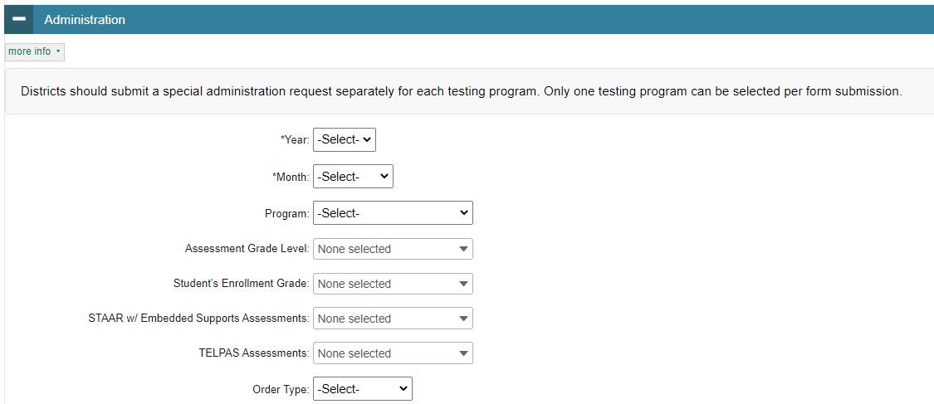
Special Administration Request Form
In the Administration section, select from each of the drop-down menus.

Slide 11
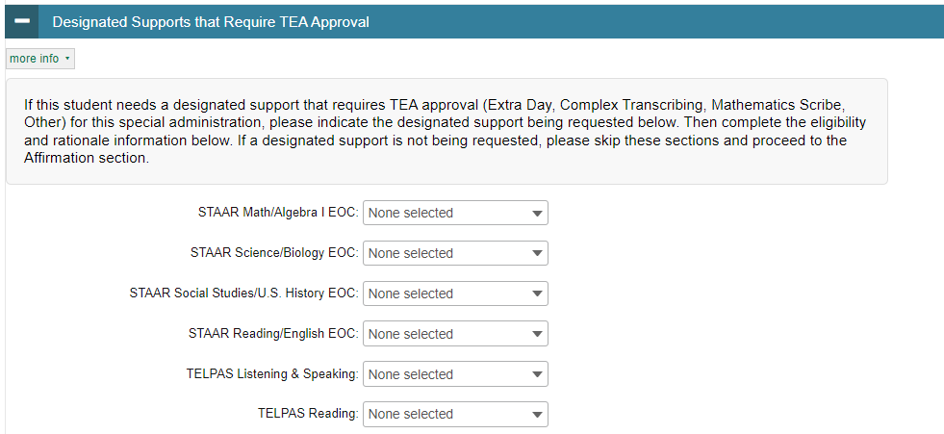
Special Administration Request Form
If the student who is receiving the special administration also needs a designated support that requires TEA approval, indicate the designated support being requested in this section and verify that the student uses the designated support during classroom instruction and testing. If a designated support is not being requested, skip this section and proceed to the affirmation section of the form.

Slide 12
Special Administration Request Form
For each designated support that was selected, you must indicate how the student meets the eligibility criteria.

Slide 13
Special Administration Request Form
In the Accommodation Rationale section, provide the information that is required for each designated support being requested.
Use your mouse to drag the rationale box to make it bigger.

Slide 14
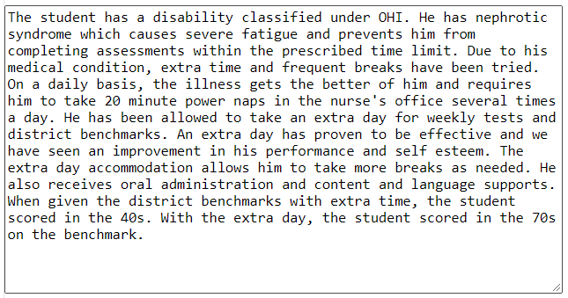
Special Administration Request Form
Below is an example of an incomplete rationale for the Extra Day accommodation and an example of a rationale that has the required information for the Extra Day accommodation.
Incomplete Rationale
Complete Rationale

Slide 15
Special Administration Request Form
If the student was approved in a previous year for the same designated support that is currently being requested, provide the prior year request ID. This facilitates quicker processing of the current request.
Next, enter a local tracking number (optional) and upload supporting documentation for the support being requested. Confidential student information, such as pages from an IEP or medical documents, should never be attached to a request. Attachments providing additional support for your rationale should include only a summary of local documentation.

Slide 16
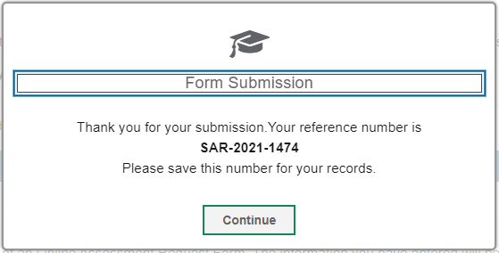
Special Administration Request Form
Upon submission of the form, the submitter will receive a request ID number. This request ID should be recorded or printed for future reference.

Slide 17
Special Administration Request Form
If the submitter is not the DTC, the request will be forwarded to the DTC for approval to process. The submitter will be copied on communication about the request.
The submitter and the DTC will be contacted about any additional information that is needed.
Requests may take a week or more to process.
The DTC and the submitter will receive special administration request decisions via email. It is important to read the email communication thoroughly, as it may contain additional instructions.
If there are any questions about the Special Administration Request process, please contact the Texas Support Center at 833-601-8821.

