Slide 1
Spring Updates: 2022 TELPAS and TELPAS Alternate
Student Assessment Division
Texas Education Agency

Slide 2
TELPAS

Slide 3
TELPAS 2022 Updates
TELPAS Overview
TELPAS Test Administrator Manual
TELPAS Training Requirements
TELPAS Rater Training in LMS
TELPAS Rater Credentials and Writing Collections
TELPAS Listening and Speaking and Reading (Practice and Released Tests)
Braille Version of TELPAS Reading
TELPAS Grades 2-12 Writing Field Test and Accommodations
Students moving within TELPAS window
DEI holistic ratings and TIDE appeals (do-not-score designations)

Slide 4
TELPAS Overview
TELPAS annually assesses the progress that English learners (ELs) make in learning the English language.
All K–12 students classified as emergent bilingual LEP/EL in the Public Education Information Management System (PEIMS) are required to participate in TELPAS, including those who have parents who have declined bilingual/English as a Second Language (ESL) program services.
*Note that when this resource and training resources refer to English learners (ELs), it applies to students identified as emergent bilingual (EB), per the terminology changes made in 87th Texas Legislature.

Slide 5
TELPAS Components
Grades K–1
Grades 2–12
Holistically-rated Assessments
Holistically-rated Assessments
Online Tests
Listening
Speaking
Writing
Reading
Reading
Writing
Listening and Speaking
TELPAS administration window is February 21st to April 1st.

Slide 6
Exceptions to an EL Being Assessed in One or More Language Domains
An EL receiving special education services
Decision must be made by ARD committee in conjunction with the LPAC.
Participation must be considered on a domain-by-domain basis.
Reason for not assessing student must be well-supported and documented.
An EL from another Texas school district, state, or country who enrolls on or after the first day of the TELPAS testing window
Will not be assessed by receiving district in the holistically-rated domains.
Is required to take the TELPAS reading test and the listening and speaking test.

Slide 7
Special Administration of a TELPAS Online Test
In rare circumstances that prevent a student from testing online, TEA may grant approval for a special administration of a TELPAS online test (listening and speaking or reading) for grades 2–12.
Accommodations cannot be applied
Technology access is precluded
Unable to participate in one domain*
The decision to recommend a special administration of TELPAS must be determined by the appropriate team of people at the campus level (e.g., RtI team, student assistance team, 504 team).
TELPAS reading requests are for paper versions, while TELPAS listening and speaking requests are for holistic assessments that require training and calibration to administer. Request can be found in the Preparing for Testing section in Test Information Distribution Engine (TIDE).
*The ARD committee, in conjunction with the LPAC, have determined the student is exempt in one domain of the TELPAS listening and speaking assessment.

Slide 8
Special Administration Request Form in TIDE

Slide 9
Special Administration Request Form

Slide 10
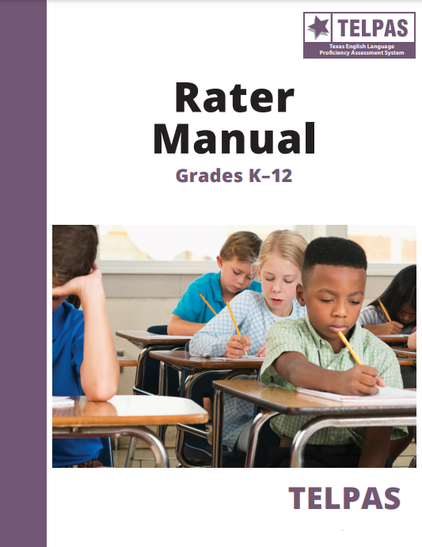
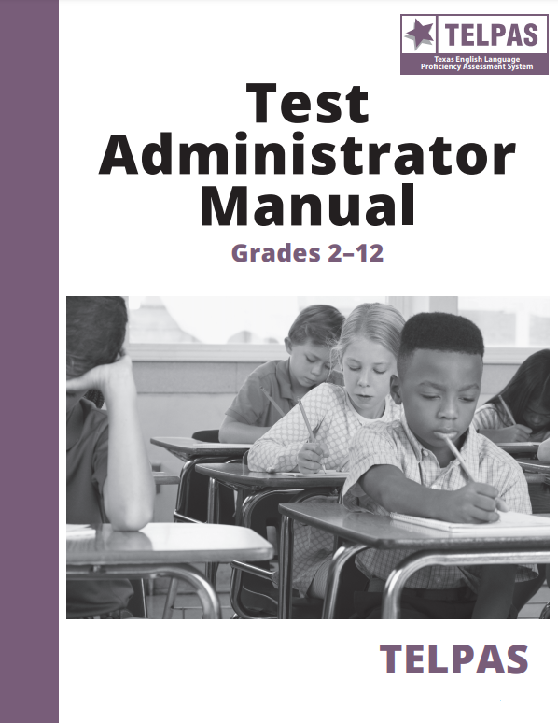
TELPAS Manuals: Rater and Test Administrator
TELPAS Rater Manual
Online only
TELPAS Test Administrator Manual
Online as well as printed and shipped
New process
Based on historical quantities
10% overage
Formula similar to STAAR, 1:15
Districts able to order additional manuals
NEW

Slide 11
TELPAS Key Dates
TELPAS (Grades K-12 Listening, Speaking, Reading and Writing) Assessment Window | February 21 to April 1
TELPAS online training opens in LMS | January 10
Assembling and Verifying Grades 2–12 Writing Collections course available | January 10
Online basic training courses for new K–1 and 2–12 raters available | January 24
Calibration window opens for new and returning raters | February 7
Earliest eligibility date for TELPAS writing samples | February 7

Slide 12
Senate Bill 1267 Changes to TELPAS Training
NEW
TEA may not require educators to repeat rater calibration activities that they have previously successfully completed.
An exception exists and allows TEA to require rater calibration activities if there have been significant changes to the program.
Campus testing coordinators may, with discretion, require other educators to complete additional training and/or rater calibration activities.
An educator, who will serve as a rater, may not be required to complete rater calibration activities in one sitting.
A district/campus will need to determine their own process to ensure that security and confidentiality measures are still in place if calibration will be allowed in more than one sitting.

Slide 13
TELPAS Training Requirements
NEW
All educators, serving as raters, are required to successfully complete rater calibration activities at least once.
All educators involved in TELPAS holistic ratings are responsible for signing a test security oath each year and complying with state holistic rating requirements.
Campus testing coordinators may, with their discretion, require other educators involved in TELPAS holistic ratings to complete additional training and/or repeat rater calibration activities.

Slide 14
TELPAS Training Requirements for 2021–2022
NEW
An exception in the law exists that allows TEA to require rater calibration activities if there have been significant changes to the program.
Because the calibration activities are changing this year as they transition to the new LMS, rater calibration activities will be required for the 2021–2022 school year.
All educators serving as raters are required to successfully complete rater calibration activities this year.

Slide 15
TELPAS Holistic Components

Slide 16
Holistic Training Required
New raters in grades K–1 complete an online basic training course, which includes practice rating activities for each language domain – listening, speaking, reading, and writing.
New raters in grades 2–12 complete an online basic training course and practice rating activity in the domain of writing.
New raters and returning raters complete calibration activities to ensure that they are prepared to apply the PLD rubrics consistently and accurately.

Slide 17
TELPAS Rater and Assembling and Verifying Training Modules
The TELPAS rater and assembling and verifying training modules will now be in the Texas Assessment's Learning Management System (LMS).
If an educator does not already have an account in LMS, they will need to create an account by entering their email address and click on “Continue to Trainings.”
An account can be created at any time.
A keyword is no longer needed to create an account.

Slide 18
Creating an Account in LMS

Slide 19
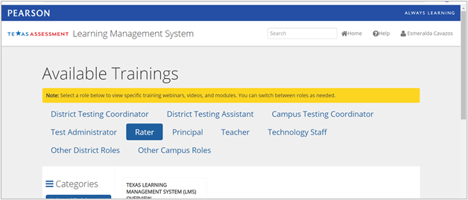
TELPAS Rater and Assembling and Verifying Training Modules
The TELPAS rater and assembling and verifying training modules will now be in the Texas Assessment's Learning Management System (LMS).
Select Rater on the Available Trainings landing page.
The Assembling and Verifying Modules can also be found under the Other Campus Roles tab.

Slide 20
TELPAS Rater Courses and Calibration
Courses and calibration sets are listed under the Categories column on the left side.
All calibration sets and the listening and speaking courses will require a passcode.
Passcodes will be posted for DTCs in the TIDE inbox on February 2nd.
New raters must complete online basic training before completing calibration activities.
All raters must complete calibration activities before rating.
Note: The TELPAS Holistically Rated Listening and Speaking modules and calibration sets are only for those approved for a special administration of a TELPAS grades 2–12 listening and speaking test.

Slide 21
TELPAS Calibration and Courses in LMS
Courses are listed underneath the calibration sets/activities.

Slide 22
Course/Calibration Description and Completion
Each course/calibration has its own description and what needs to be completed in order to receive continuing professional education (CPE) hours.
The yellow bar indicates the number of trainings that need to be completed to earn a certificate for a course. It will also serve as a status bar on the number of trainings the educator has completed.

Slide 23
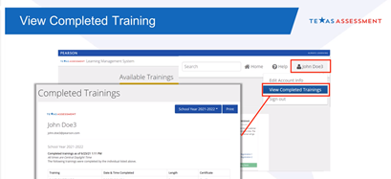
LMS Training History
The LMS will keep each user's training history and any continuing professional education (CPE) hours earned.
A user will need to click on their name at the top right corner and then click on View Completed Trainings from the drop-down menu.
Only successful calibrations will show as completed and provide a certificate on the Completed Trainings page.

Slide 24
LMS Training Certificates
NEW
Users can print the certificate from their Completed Trainings report.
It is recommended that users print and keep a copy of their certificate(s).

Slide 25
LMS Administrator Access
LMS Administrator access for the districts and campuses is limited to specific user roles: ESC Region Staff (ERS), District Testing Coordinator (DTC), District Testing Assistant (DTA), Campus Testing Coordinator (CTC), and Principal (PR).
Administrator access for the LMS is updated based on a daily extract. It is not completed in real time with user updates.

Slide 26
LMS Administrator Reports
NEW
Administrator access to the LMS will allow you to view reports on users and their training history.
Users with administrator access will have the Administrator tab on their account. After selecting Administrator, they will select Reports.
Administrator users at a district level will have access to district and campuses/schools.
Administrator users at a school level will have access to their campuses/schools.

Slide 27
LMS Administrator Reports, (cont.)
NEW
View Overview—Lists name of training or course and number of users who started and finished each training or course.
View Staff Records—Lists name of user, training or course, and date started and finished.*
Download Excel Report—Overview Tab shows training/course title and number of users who started and finished each training/course. The Staff Records tab shows district code, name of organization, name of user, training/course and date started and finished.
*On the Staff Records report, calibrations that do not meet sufficient calibration will not appear as Finished.

Slide 28
Grades K–1 Rater Credentials
A teacher (including a substitute teacher) selected to rate an EL must
have the student in class at the time of the spring assessment window
be knowledgeable about the student’s ability to use English in instructional and informal settings
hold valid Texas education credentials, such as a teacher certificate or permit
be appropriately trained in the holistic rating process
rate the student in all eligible domains
Raters may include bilingual teachers, ESL teachers, general education teachers, gifted and talented teachers, and teachers of enrichment subjects. Paraprofessionals may not serve as raters.

Slide 29
Grades 2–12 Rater Credentials (Writing Only)
A rater does not need to have the student in class at the time of the spring assessment.
The rater (including a substitute teacher) selected to rate an EL must
hold valid Texas education credentials, such as a teacher certificate or permit
be appropriately trained in the holistic rating process*
It is important to note that teachers are still required to assemble writing collections.
Districts that designate centralized raters (districtwide, campuswide, or by grade levels) will need to develop their own process to gather and verify the writing collections.
Paraprofessionals may not serve as raters.
*Please note that campus testing coordinators, at their discretion, can implement additional training requirements for grades 2–12 raters of writing collections.

Slide 30
TELPAS Writing Collections: Centralized Raters
Districts still have the option to designate one or more centralized raters to rate TELPAS grades 2–12 writing collections districtwide, campuswide, or by grade level.
The centralized raters will still have to meet the TELPAS rater requirements (training and calibration).
Exception: This does not apply to raters of students that have been approved for a special administration of the TELPAS listening and speaking assessment.

Slide 31
TELPAS Writing Collections: Centralized Raters
Teachers of ELs in grades 2–12 are still required to assemble an EL’s writing collection to be rated.
Teachers assembling the writing collection(s) are required to receive TELPAS administration procedures training, at least once, in order to ensure that writing collections are assembled appropriately.
Districts using centralized raters will need to develop their own process to gather the writing collections districtwide, campuswide, or by grade level.

Slide 32
Grades 2–12 Rater Credentials (Listening, Speaking, and Writing)
In rare circumstances, an EL may be approved for a special administration for the listening and speaking domains. In this situation, the teacher must rate the student in all the eligible domains.
A teacher (including a substitute teacher) selected to rate an EL must
have the student in class at the time of the spring assessment window
be knowledgeable about the student’s ability to use English in instructional and informal settings
hold valid Texas education credentials, such as a teacher certificate or permit
be appropriately trained in the holistic rating process
rate the student in all eligible domains
Raters may include bilingual teachers, ESL teachers, general education teachers, gifted and talented teachers, and teachers of enrichment subjects. Paraprofessionals may not serve as raters.

Slide 33
TELPAS Training and Calibration in a Remote Setting
The online basic training may be completed in a remote setting and should be completed independently. This course is divided into modules so that it can be completed in more than one sitting, if necessary.
Monitored calibration activities may be conducted in a virtual or remote setting (e.g., Zoom, TEAMS meeting, Google Meet, etc.).
A district, at their discretion, may require face-to-face monitored calibration activities. However, they must still adhere to appropriate public health protocols. Individuals are not authorized to serve as TELPAS raters until they complete the state-required training and calibration activities.

Slide 34
Monitored Calibration Activities in Remote/Virtual Settings
Calibration proctors must be able to view all participants in a session on one screen as they complete their calibration activity.
Participants should remain in the proctor’s view at all times.
A calibration proctor may not have a session with breakout groups and should not need to scroll to see all the participants at one time.
In addition, the chat or message feature should be disabled since raters are required to calibrate independently.

Slide 35
TELPAS Holistic Components: Ratings
Holistic Ratings (beginning, intermediate, advanced, and advanced high) will be entered in Cambium’s Data Entry Interface (DEI).

Slide 36
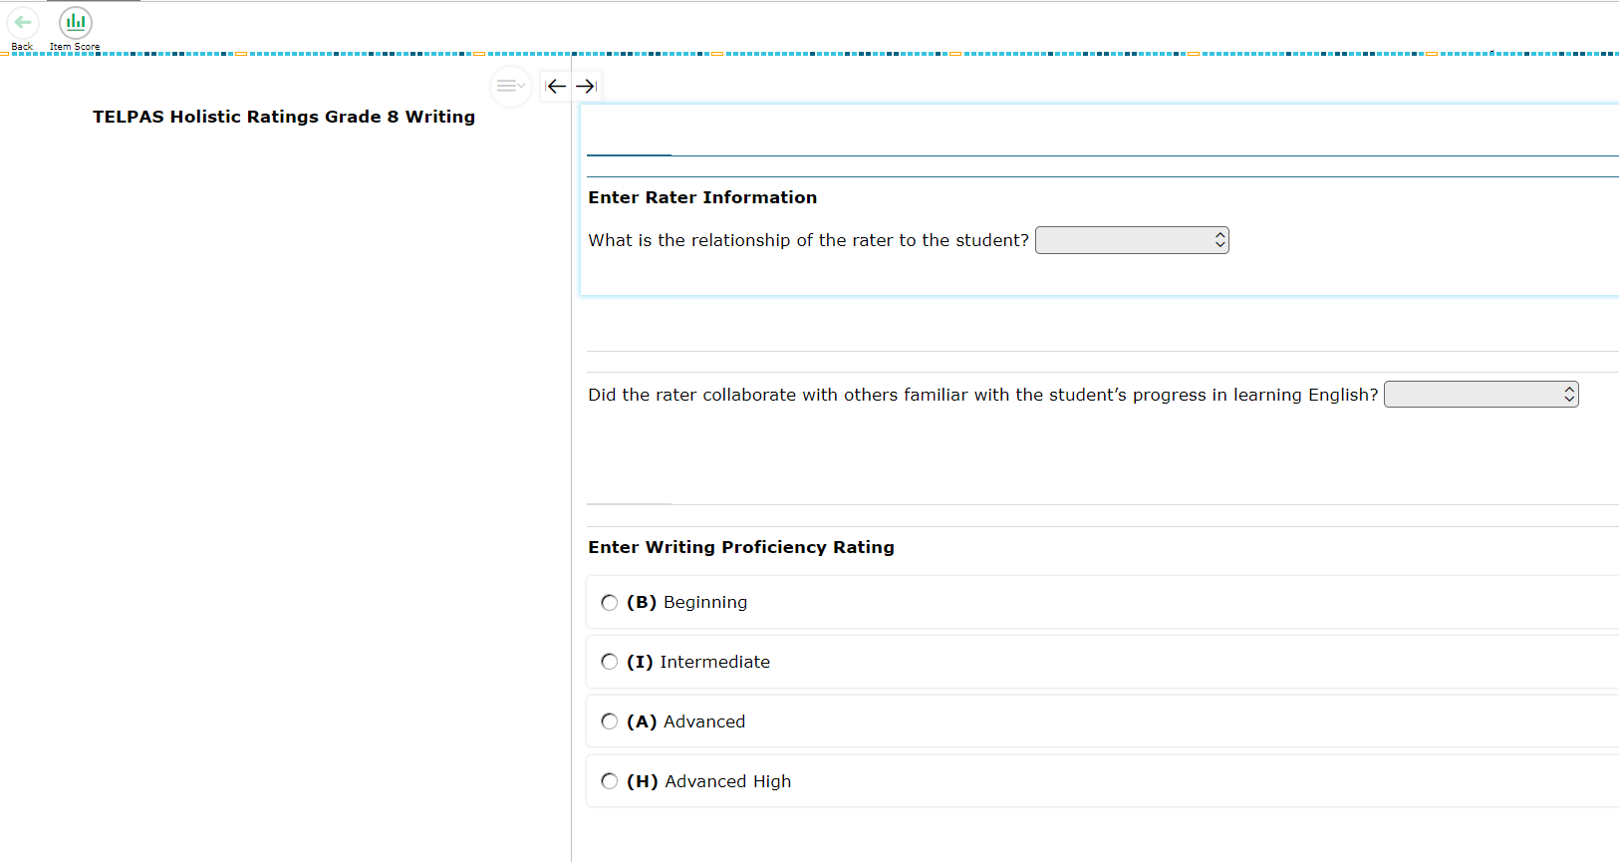
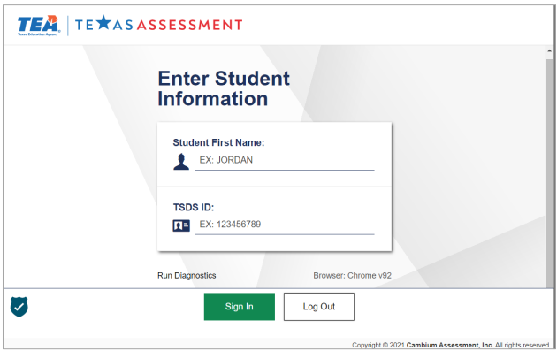
Entering Holistic Ratings in DEI

Slide 37
TELPAS Holistic Components: Score Codes
Score codes for TELPAS holistic components include the following:
ARD-Decision (X)
Extenuating Circumstances (E)
Score codes for TELPAS holistic components will be entered in TIDE.

Slide 38
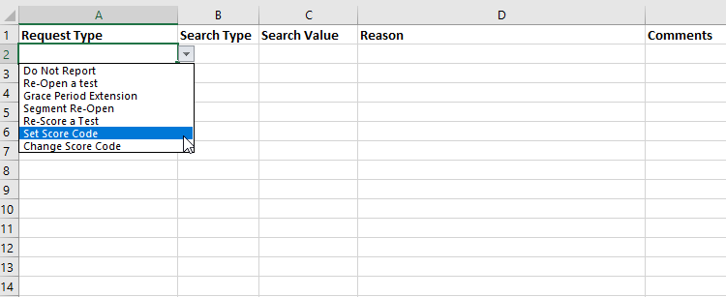
Do-Not-Score Designations in TIDE

Slide 39
TELPAS Online Assessments

Slide 40
Updated TELPAS Listening and Speaking Practice Sets
Have been updated to reflect format changes due to new testing platform
Are solely for practice (should not be used to predict success on TELPAS)
Help students become familiar with online listening and speaking item functionality
Include sample items comparable to what is on the actual test
should not be treated like released tests
not a true reflection of the various difficulty levels of items on the test
Allow students to practice listening to test items and to practice recording and listening to speaking responses
NOTE: There are no longer any separate, standalone TELPAS tutorials. Students should have multiple opportunities to practice interacting with the new online testing platform.

Slide 41
Updated TELPAS Reading Practice Sets
Updated to reflect format changes due to new testing platform
Purpose is to familiarize students with the online interface, the available tools, and the types of test items
Include a sampling of reading passages and test questions
Sample items comparable to what is on the actual test
should not be used to evaluate a student’s level of language proficiency
not a true reflection of the various difficulty levels of items on the test
NOTE: There are no longer any separate, standalone TELPAS tutorials. Students should have multiple opportunities to practice interacting with the new online testing platform.

Slide 42
Updated TELPAS Listening & Speaking and Reading Released Tests
Have been updated to reflect format changes due to new testing platform
Can be administered to students for diagnostic purposes
To generate a score report, the student must submit their final answers.
For listening and speaking, speaking items will not be scored. Campuses may develop a plan to score spoken responses using the speaking rubrics on the TELPAS Resources webpage.
To determine a student’s proficiency level rating, use the appropriate raw score conversion table located on the TELPAS Raw Score Conversion Tables webpage.

Slide 43
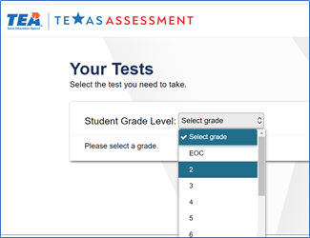
TELPAS Released and Practice Tests

Slide 44
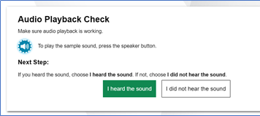
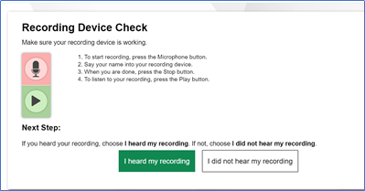
Audio Playback and Recording Device Checks
If an assessment has multimedia features, like the TELPAS listening and speaking test, there will be audio playback and recording device checks that must be completed, before a student can start their test.

Slide 45
Developing TELPAS Grades 2–12 Writing Domain as an Online Assessment
NEW
Given stakeholder feedback and training limitations, we are developing a standardized writing test and proposing a combined reading and writing online test administration.
Less administrative burden than two separate tests
Similar to existing listening and speaking online tests
As part of the development process, TELPAS writing field-test questions will be embedded in all TELPAS reading forms this spring.
The embedded writing field-test questions are designed to collect data and will not count toward a student’s TELPAS reading or writing score.
For 2021–2022, TELPAS student writing collections are still required to be collected and rated for a student’s proficiency rating.
GOAL: Operational TELPAS reading and writing assessment in spring 2023

Slide 46
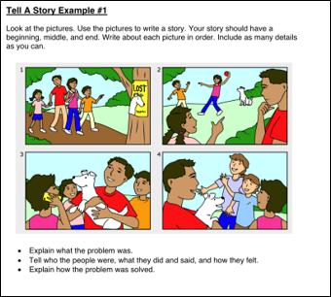
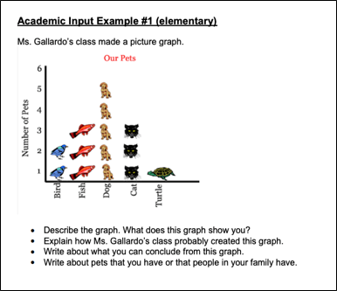
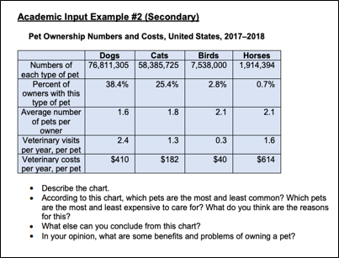
TELPAS Writing Constructed Response Samples

Slide 47
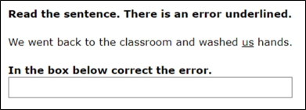
TELPAS Writing Text Entry Samples

Slide 48
2021-2022 Accommodations for TELPAS Embedded Writing Field-Test Questions
A 2021–2022 Accommodations for TELPAS Writing Field Test Guidance document will be posted on the Accommodations Resources webpage.
The purpose of this document is to provide guidance regarding accessibility and designated supports specifically for the TELPAS writing field-test questions.
The guidance document will include information about accessibility and designated supports that have been identified as applicable for the TELPAS embedded writing field-test questions.
If a student needs a designated support(s) for the TELPAS reading test, refer to the 2021-2022 accessibility features and designated supports policy documents.

Slide 49
Accessibility Features for TELPAS Embedded Writing Field-Test Questions
As with other test administrations, certain accessibility features may be provided for the TELPAS writing field-test questions. As a reminder, in general, these procedures and materials are available to any student who regularly benefits from their use during instruction.
A student cannot be required to use accessibility features during testing, and there is no need to document their use in TIDE for online test administrations.
If the administration of an accessibility feature requires a trained test administrator to view secure test content, they must be trained on how to implement the procedure and sign the appropriate section of the Oath of Test Security and Confidentiality.

Slide 50
Designated Supports for TELPAS Writing Field-Test Questions: Policy Information Overview
A designated support should only be provided if the student meets the eligibility criterion/criteria.
It will not be required for the applicable committee to meet or document the designated support provided to a student for the TELPAS writing field-test questions; however, the student must meet the eligibility criterion/criteria and the designation should be based on the student’s need for the designated support.
The correct attribute(s) for a student’s designated support(s) for the TELPAS writing field-test questions should be noted in TIDE.

Slide 51
Designated Supports for TELPAS Writing Field-Test Questions
Basic Transcribing and Complex Transcribing have been identified as designated supports that may be provided to students for the TELPAS writing field-test items.
However, the actual type of support provided for the TELPAS writing field-test questions varies from what is allowed for STAAR and what is currently included in the accommodation policy documents.

Slide 52
Overview of Basic Transcribing for TELPAS Writing Field-Test Questions
For the purpose of the TELPAS writing field-test questions, basic transcribing includes only the following:
The student points to responses on the computer screen for test questions.
The student dictates or signs responses for test questions.
The student writes responses on another workspace (e.g., scratch paper, dry erase board) for test questions or the writing prompt.
The student uses speech-to-text (STT) technology to indicate responses for the writing prompt, including use of the online embedded support in TDS.
Refer to 2021-2022 Accommodations for TELPAS Writing Field-Test Questions Guidance document for additional policy information and guidance on Basic Transcribing for writing field-test items.

Slide 53
Overview of Complex Transcribing for TELPAS Writing Field-Test Questions
In order for a student to receive complex transcribing, the student must meet all the following eligibility:
The student routinely and effectively uses this designated support during classroom instruction and classroom testing;
The student is unable to effectively use Basic Transcribing to address this need; and
The student has a physically disabling condition (e.g., muscular dystrophy, cerebral palsy, arthritis) that prevents him or her from independently and effectively recording responses in the space provided in the Test Delivery System (TDS).
Complex transcribing generally requires an Accommodation Request Form (ARF) to be submitted for TEA approval. However, for the purpose of the TELPAS writing field-test questions, an ARF will not need to be submitted for TEA approval.
Refer to 2021-2022 Accommodations for TELPAS Writing Field-Test Questions Guidance document for additional policy information and guidance for Complex Transcribing for writing field-test items.

Slide 54
Text-to-Speech (TTS) for Embedded TELPAS Writing Field-Test Items
Text-to-Speech (TTS) will be provided for the prompts of TELPAS writing field-test questions for all students.
Students do not need to meet eligibility criteria for text-to-speech.
TTS is not automatic. Students must select any eligible text to be read aloud.
Due to the TTS for the embedded writing field-test items, students will need access to headphones and a keyboard for the online TELPAS reading test.
Students that need speech-to-text (STT), will require headphones with microphones. As a reminder, students need to meet eligibility criteria for STT.

Slide 55
TELPAS Writing Item Sampler Set
A TELPAS writing item sampler set will soon be available.
The sampler set will reflect the format and features of the writing items. It is not grade cluster specific.
The purpose of the writing sampler set is to familiarize students with the online interface, the available tools, and the different types of writing items (constructed response and text entry items).
Sample items are comparable to what is on the actual test
should not be used to evaluate a student’s level of language proficiency
not a true reflection of the various difficulty levels of items on the test

Slide 56
Scheduling Online TELPAS Tests
TELPAS online tests are not timed.
Students must be allowed to work at their individual speed. Once a student begins a test, he or she must complete it on the same day.
Districts are not required to test beyond regular school hours but are free to do so if they choose.
Districts should exercise judgment about starting a test session after lunch, as some students may not have enough time to work at their individual speed to respond to the test questions before the end of the school day.

Slide 57
Braille Version of TELPAS Reading
NEW
Available starting in spring 2022
ARD committee, in conjunction with LPAC, decision
Same grade bands as TELPAS online reading (2, 3, 4–5, 6–7, 8–9, 10–12)
An EL may use this designated support if he or she routinely uses braille materials during classroom instruction and classroom testing.
Brailled test materials only
Districts can order TELPAS braille materials during the additional materials order window, 1/24-2/11, and submit their order in TIDE.
Student's responses to the braille version of TELPAS reading test will need to be submitted in DEI.

Slide 58
TELPAS Reading Paper and Braille Versions in DEI
If a special administration of an online TELPAS reading test was approved, the student's responses from the paper test will need to be submitted in DEI.
A student's responses for the braille version of the TELPAS reading test will need to be submitted in DEI.

Slide 59
Students Moving within TELPAS Administration Window
Students can only be actively enrolled in one district/campus in TIDE. If a student moves during the administration window, TELPAS tests (including holistic ratings) will follow the student.
Rating information or score code (if applicable) can only be entered by a user in the district/campus where the student is enrolled.
Once the receiving district has enrolled the student in TIDE, the sending district will not be able to enter the student’s rating(s) or score code (if applicable) online.

Slide 60
Coordination between Sending and Receiving Districts/Campuses
Sending districts will need to coordinate with the receiving districts in order to provide them with the rating(s), including the rater information, or score code (if applicable).
Districts can share the information using the secure inbox in TIDE, as an attachment (EXCEL spreadsheet, word or PDF document, etc.).
Reminder: If an EL enrolls in a Texas public school BEFORE February 21 (the start of the TELPAS assessment window), the receiving campus is responsible for all TELPAS assessments. If an EL enrolls ON or AFTER February 21, the receiving campus is responsible only for the grades 2–12 online tests (if the tests were not already administered). The sending campus is responsible for the holistic components even if the ratings were not yet assigned or entered online.

Slide 61
Scoring of TELPAS Speaking Responses Guide
The Scoring of TELPAS Speaking Responses Guide will be available on the TELPAS Resources webpage.
The guide is an overview explaining how student speaking responses are scored by Pearson.
It will also include information on requests for rescoring speaking responses which can be made during the rescore request window noted on the Calendar of Events.
The guide is a resource for educators, administrators, and parents.
Coming soon!

Slide 62
Educator Committees
Input from Texas educators is a critical component of ensuring that the state assessments developed by the Student Assessment Division of the Texas Education Agency (TEA) are valid, reliable, high-quality measures of student achievement.
We are seeking qualified educators from your school or district to serve on statewide committees who will review potential test questions in a TELPAS Educator Committee meeting.

Slide 63
TELPAS Resources
Resource | Purpose | Audience
TELPAS and TELPAS Alternate Educator Guide | Provides an overview of TELPAS and TELPAS Alternate and serves to support effective implementation of the Texas English Language Proficiency Standards (ELPS) and PLDs to guide instruction | Administrators, Coordinators, Educators
TELPAS Training PowerPoints | Provide introductory training resources for educators, raters, and administrators/coordinators to use to build foundational knowledge of TELPAS | Administrators, Coordinators, Educators
TELPAS Manuals: Rater and Test Administrator | Provide policies and guidance for raters and test administrators | Administrators, Coordinators, Educators, Test Administrators

Slide 64
TELPAS Resources (cont.)
Resource | Purpose | Audience
TELPAS Reading, Listening, and Speaking Blueprints | Provide districts with the test blueprints (reading, listening, and speaking) including reporting categories | Administrators, Coordinators, Educators
TELPAS Speaking Rubrics | Derived from the TELPAS proficiency level descriptors (PLDs) and demonstrate the number of score points that a student can achieve based on their performance on each speaking test item | Administrators, Coordinators, Educators
TELPAS Speaking Scoring Guides | Provide exemplar student responses for the TELPAS online speaking assessment. They are intended to be used alongside the spring 2020 TELPAS listening and speaking released tests. | Administrators, Coordinators, Educators, Parents

Slide 65
TELPAS Resources (cont.)
Resource | Purpose | Audience
TELPAS Released Listening and Speaking and TELPAS Reading Tests | Available in the online interface and can be used to administer to students for diagnostic purposes | Administrators, Coordinators, Educators, Parents, Students
Answer Keys for TELPAS Released Tests | Provide answers to released tests, reporting category per item, and ELPS student expectation per item | Administrators, Coordinators, Educators, Parents, Students
TELPAS Practice Sets | Assist students in becoming familiar with online TELPAS tests (navigating through tests, online tools, and interaction with listening and speaking test items, including recording and playing speaking responses) | Administrators, Coordinators, Educators, Parents, Students

Slide 66
TELPAS Resources (cont.)
Resource | Purpose | Audience
TELPAS Parent Resources | Provide parent resources that include TELPAS FAQs and TELPAS parent tips for all language domains | Administrators, Coordinators, Teachers, Parents
TELPAS Microphone and Headset Check | Available within the TELPAS Listening & Speaking Practice Sets and TELPAS Listening & Speaking Released Tests | Administrators, Coordinators, Teachers
TELPAS Rater and Assembling and Verifying 2-12 Writing Collections Training Modules | Can be found in the Texas Assessment's Learning Management System. The modules can be found by either selecting the role of Rater or Other Campus Roles. | Administrators, Coordinators, Educators

Slide 67
TELPAS Alternate

Slide 68
TELPAS Alternate Updates for 2021-2022
TELPAS Alternate Overview
TELPAS Alternate Administration Training
TELPAS Alternate Test Administrator Manual
TELPAS Alternate Training PowerPoints with Narration
Observable Behaviors Ratings in DEI
Do-Not-Score Designations in TIDE

Slide 69
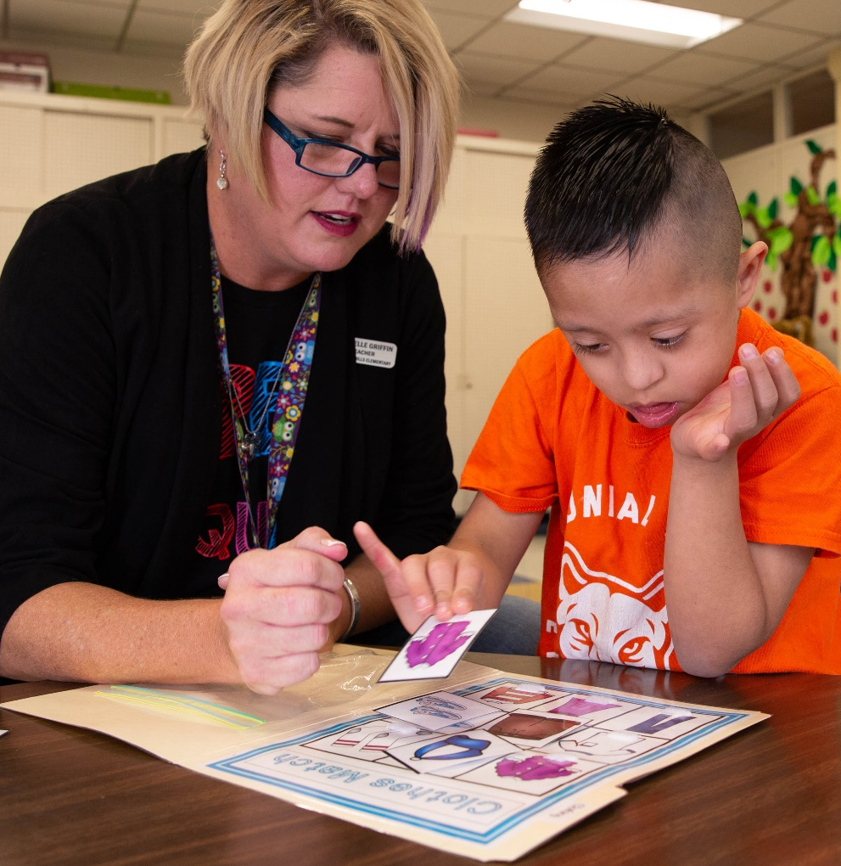
What Is TELPAS Alternate?
A holistic inventory that assesses the language domains of listening, speaking, reading, and writing for students with significant cognitive disabilities in grades 2–12
Aligned to the Texas English Language Proficiency Standards (ELPS)
Based on alternate Proficiency Level Descriptors (PLDs) created to address the specific access needs of this population

Slide 70
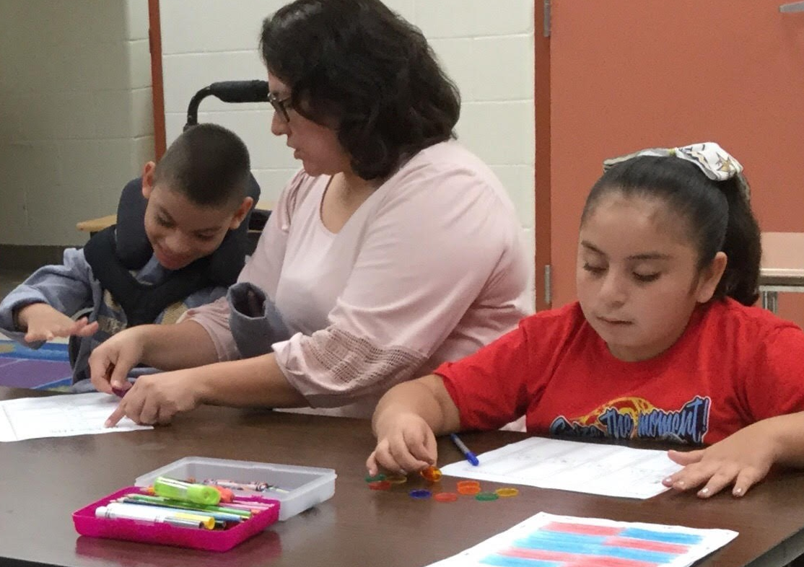
Who Takes TELPAS Alternate?
Students taking TELPAS Alternate are English learners in grades 2–12 who have significant cognitive disabilities and who are in the process of acquiring English proficiency in listening, speaking, reading, and writing.
These students have one or more disabilities that significantly limit their intellectual functioning, as shown by their ability to plan, comprehend, and reason, and their adaptive behavior, as shown by their ability to apply social and practical skills.

Slide 71
Who Is Assessed with TELPAS Alternate?
Grades K–1 | No TELPAS Alternate for K–1 at this time. All ELs, including students receiving special education services, will take the TELPAS K–1 holistically rated assessment for all four language domains.
Grade 2 | Participation requirements are available on TEA’s TELPAS Alternate Resources webpage. ARD committees, in conjunction with the LPAC, are required to review the participation requirements and determine and document student eligibility for TELPAS Alternate.
Grades 3–12 | Participation requirements are available on TEA’s TELPAS Alternate Resources webpage. ARD committees, in conjunction with the LPAC, are required to determine and document student eligibility for TELPAS Alternate. If the student is LEP/EL and is eligible for STAAR Alternate 2, he or she will take TELPAS Alternate.

Slide 72
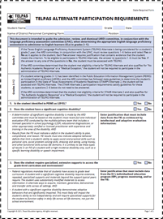
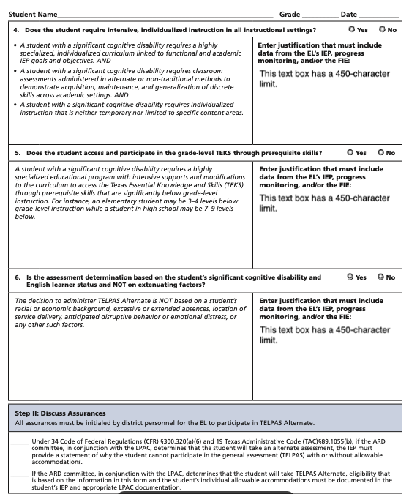
TELPAS Alternate Participation Requirements
Participation requirements (in English and Spanish) for grades 2–12 are available on TEA’s TELPAS Alternate Resources webpage.
Participation requirements are intended to guide the ARD committee, in conjunction with the LPAC, when determining the appropriate English language proficiency assessment to administer to ELs.
Documentation of eligibility is different for students in grade 2 compared to students in grades 3–12. For grade 2 eligibility, all questions will need to be answered and the assurances will need to be initialed in Step II.
For student in grades 3–12, the LPAC will answer question 1: “Is the student identified in PEIMS as LEP/EL?” and initial the assurances in Step II.

Slide 73
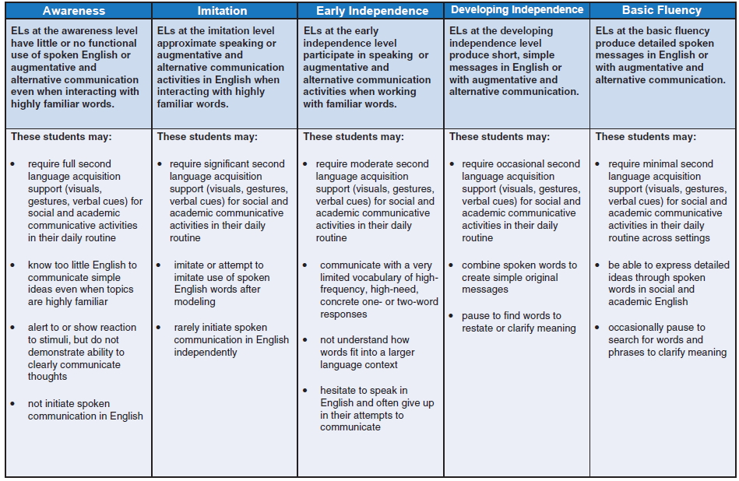
Alternate Proficiency Level Descriptors (PLDs)
The Alternate PLDs are domain-specific and define how well ELs at the five proficiency levels are able to understand and use English in social and academic settings.
The descriptors show the progression of second language acquisition from one proficiency level to the next and serve as a road map to help teachers tailor instruction to the linguistic needs of ELs.
Located on the TELPAS Alternate Resources webpage.

Slide 74
What Are Observable Behaviors?
The “questions” are called Observable Behaviors. Each Observable Behavior describes characteristics that students learning English demonstrate as they gain proficiency.
Test administrators, based on their knowledge of a student’s English language skills over a period of time, will make holistic judgments across all four domains of English language proficiency (listening, speaking, reading, writing) using alternate ELPS-aligned observable behaviors.

Slide 75
Observable Behaviors: Notes Version
A “notes version” of the Observable Behaviors can be found on TEA’s TELPAS Alternate Resources web page. It is available so that educators can become familiar with the Observable Behaviors and practice using them during the school year.

Slide 76
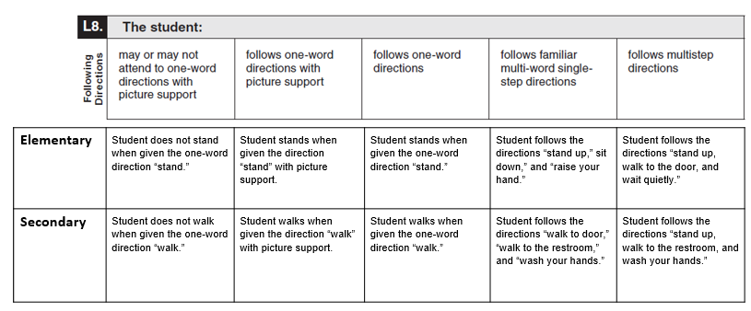
Observable Behaviors with Classroom Examples
Texas teachers developed classroom examples to help test administrators better understand the descriptions of student performance for each Observable Behavior.
Elementary and secondary examples describe one way that students could demonstrate each skill across the five levels of proficiency.
An accessible version of the Observable Behaviors and classroom examples can be found on TEA’s TELPAS Alternate Resources webpage.

Slide 77
Using the Classroom Examples
The purpose of each example is to illustrate how a student could demonstrate the skill at each proficiency level.
There are many other classroom activities that could be used as examples for the Observable Behaviors.
These examples are not intended to be used as test questions or performance tasks for teachers to replicate, although using them for this purpose is acceptable if needed.
Teachers are encouraged to use their own activities in the regular classroom setting when determining a student’s ability to understand and use English.

Slide 78
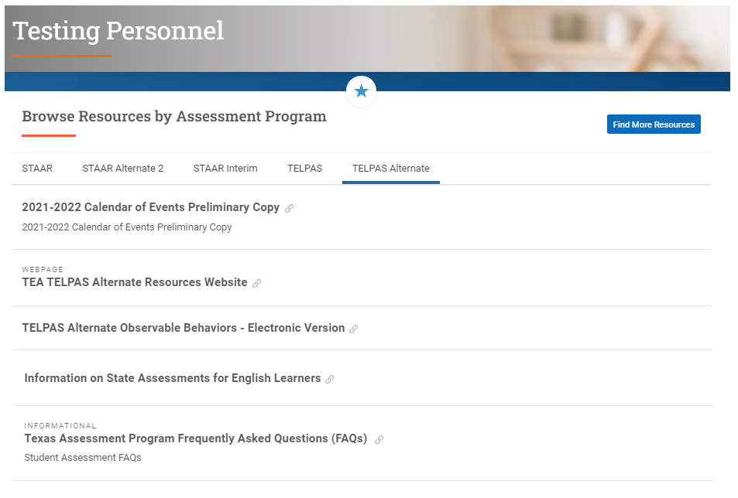
TELPAS Alternate Observable Behaviors (Electronic Version)
The TELPAS Alternate Observable Behaviors (electronic version) is posted on the Texas Assessment webpage.

Slide 79
TELPAS Alternate Administration Training
SB 1267 also has an impact on annual TELPAS Alternate administration procedures training.
As with TELPAS administration training, testing personnel are required to receive training at least once in test security and administration procedures, sign a test security oath each year, and are responsible for complying with state assessment requirements.
In addition, testing personnel must receive training at least once in testing policies and procedures specific to each administration and, if applicable, training related to security protocols for authorized viewing of state assessments.

Slide 80
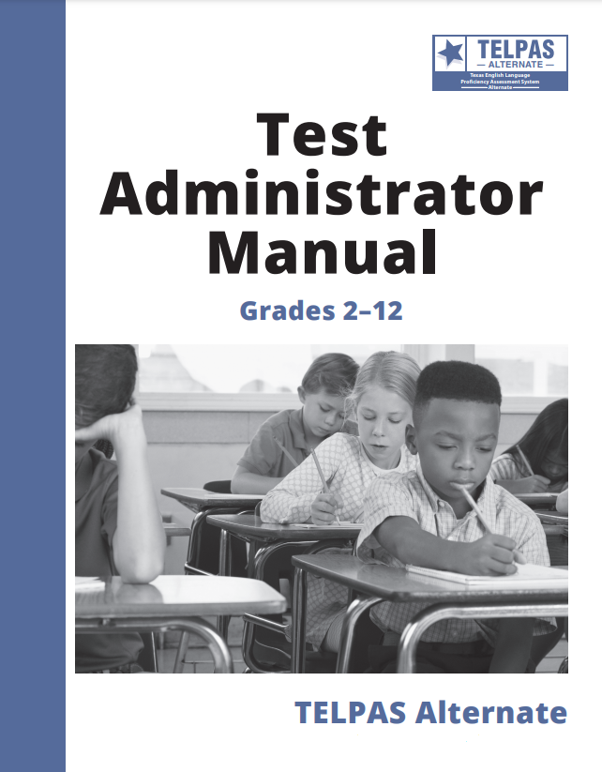
TELPAS Alternate Test Administrator Manual
NEW
Manuals
available online only
not shipped to districts
Observable Behaviors shipped to districts
Based on registration counts + 10% overage
Observable Behaviors will be packed in 3’s
Districts are not able to place additional orders
Observable Behaviors PDF available online for printing
TELPAS Alternate assessment window is February 21 to April 1.

Slide 81
TELPAS Alternate: Observable Behaviors Ratings
Observable Behaviors Ratings (awareness, imitation, early independence, developing independence, and basic fluency) will be entered in Cambium’s Data Entry Interface (DEI).

Slide 82
Entering Ratings for Observable Behaviors in DEI
DEI will have one screen with 10 Observable Behaviors per language domain and ratings A-E corresponding to the Observable Behavior document.
Users will click through four screens to enter ratings for all four language domains before submitting.
In order to submit ratings, a student should have ratings for all 40 Observable Behaviors.
If a student is not rated in all 40 Observable Behaviors, no ratings can be submitted; in those cases, the appropriate score code (E, N, or M) should be entered in TIDE.

Slide 83
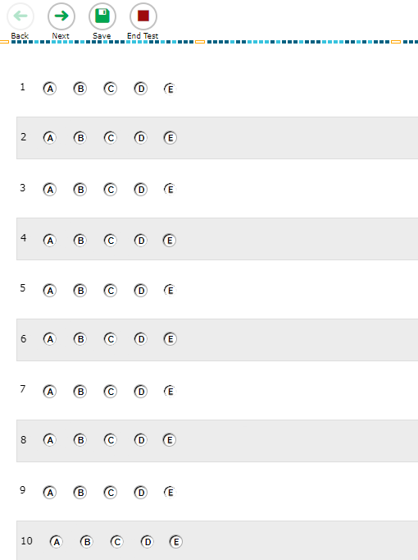
Entering Ratings for Observable Behaviors in DEI (continued)

Slide 84
TELPAS Alternate: Score Codes
Score codes for TELPAS Alternate include the following:
Extenuating Circumstances (E)
Medical Exception (M)
No Authentic Academic Response (N)
Score codes for TELPAS holistic components will be entered in Cambium’s Test Information Distribution Engine (TIDE).

Slide 85
Screenshots of TIDE Appeals and File Upload

Slide 86
TELPAS Alternate Training
TELPAS Alternate Test Administrator Manual
A series of training PowerPoints is available on TEA’s TELPAS Alternate Resources webpage. Each PPT can be reviewed in about 10–15 minutes.
Introduction to TELPAS Alternate
TELPAS Alternate Student Eligibility
TELPAS Alternate Accessibility
TELPAS Alternate Listening Domain
TELPAS Alternate Speaking Domain
TELPAS Alternate Reading Domain
TELPAS Alternate Writing Domain
TELPAS Test Administration
While the PPTs are not required, TEA highly recommends that test administrators assessing students using TELPAS Alternate view these PPTs to become familiar with unique aspects of a TELPAS Alternate administration.
TELPAS Alternate training PowerPoints with narration are available in the LMS under the Teacher tab in the courses section. If an educator completes all the TELPAS Alternate trainings in the LMS, they will receive CPE hours.

Slide 87
TELPAS Alternate Resources
Resource | Purpose | Audience
TELPAS and TELPAS Alternate Educator Guide | Provides an overview of TELPAS and TELPAS Alternate and serves to support effective implementation of the ELPS | Administrators, Coordinators, Teachers
Participation Requirements | Used by ARD committee, in conjunction with the LPAC, to make decisions about TELPAS Alternate | Members of ARD committees and LPACs
Observable Behaviors (Notes Version) | Measure the student’s use of English and contain a notes section that can be used to become accustomed to TELPAS Alternate prior to the assessment window | Educators
Observable Behaviors (Classroom Examples) | Provide elementary and secondary classroom examples to help test administrators better understand the descriptions of student performance for each Observable Behavior | Educators

Slide 88
TELPAS Alternate Resources (cont.)
Resource | Purpose | Audience
Observable Behaviors (electronic version) | Can be used to capture students’ ratings so they can be submitted in the DEI | Teachers serving as test administrators
Test Administration Manual | Contains instructions covering the responsibilities of test administrators and the observable behaviors used to assess students Required to be read carefully and followed as written | Administrators, Coordinators, Teachers serving as test administrators
Training PowerPoints | Provide training on a variety of topics, including authentic classroom activities for each domain that explain how to rate students with the observable behaviors Are optional though highly recommended; PPTs with narration are posted on the Texas Learning Management System under Teacher courses. | Administrators, Coordinators, Teachers serving as test administrators
Parent Brochure | Communicates (English and Spanish) basic information about TELPAS Alternate | Parents

Slide 89
Texas Testing Support
Simplified phone support menu
Phone: (833) 601-8821
New chat feature
TexasTestingSupport@cambiumassessment.com
Texasassessment.gov
Testing Personnel section is the new “one-stop” for all assessment resources

Slide 90
TEA Contact Information
For inquiries related to development and
administration of state assessments please contact:
Student Assessment Help Desk
(512) 463-9536
https://tea.Texas.gov/student.assessment/
For inquiries related to reporting activities and
data corrections please contact:
performance.reporting@tea.texas.gov
(512) 463-9704​
Performance Reporting Division

Slide 91
Disclaimer
These slides have been prepared by the Student Assessment Division of the Texas Education Agency. You are encouraged to use them for local training.
If any of the slides are changed for local use, please hide or remove any TEA logos, headers, or footers. (You may need to edit the Master slide.) In addition, you must remove the photographs. Only TEA has parental permission to use these photographs for training purposes.
This training is not intended to replace any materials or additional information on the TEA website.

