Slide 1
Recruiting, Preparing, and Retaining Top Teachers
TEA Learning Roundtable
@Doug_Lemov
January 31, 2018

Slide 2
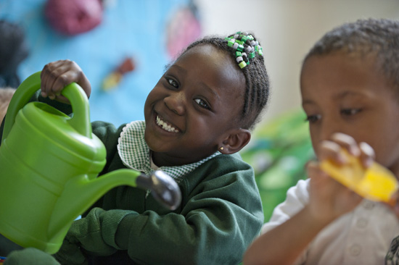
This Work Matters

Slide 3
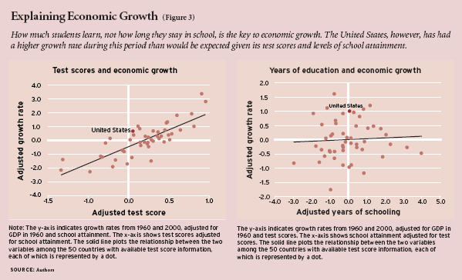
Big Picture, Too
Notes:
When you look into it a bit it turns out that teaching is arguably the most important job in our societies. Hanushek found that roughly 80% of GDP growth in western hemisphere nations over 40 year period correlated to measured quality of schooling. Let me define that a little. So in addition to all that hopes and dreams and aspirations business, teachers drive the economy. Both in the aggregate and in the individual sense. That is- whether your child participates in it,.

Slide 4
But It Is Very, Very Difficult
Notes:
Consider also the other teachers in her school, where the failure rate is 50%!!!
Consider the teachers in all the other schools…
What other profession fails at that rate???

Slide 5
The failure rate of teachers in some districts is 50% over three years, according to TNTP.
Notes:
Consider also the other teachers in her school, where the failure rate is 50%!!!
Consider the teachers in all the other schools…
What other profession fails at that rate???

Slide 6
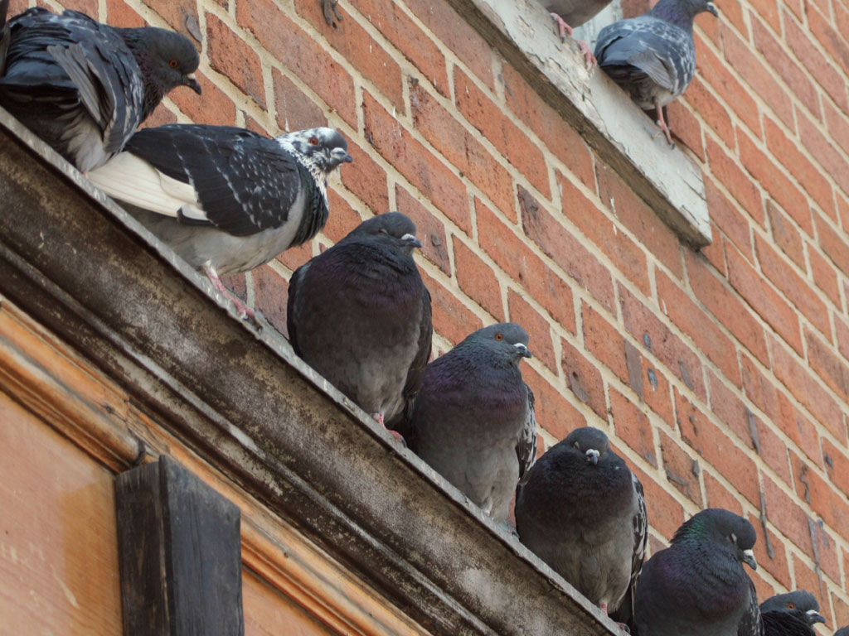
While Some Challenges are Unpredictable…
Notes:
Consider also the other teachers in her school, where the failure rate is 50%!!!
Consider the teachers in all the other schools…
What other profession fails at that rate???

Slide 7
…Many are Predictable
Notes:
Consider also the other teachers in her school, where the failure rate is 50%!!!
Consider the teachers in all the other schools…
What other profession fails at that rate???

Slide 8
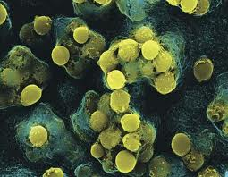
Breakthroughs in innovation have historically been preceded by breakthroughs in measurement*.
*Even when it is imperfect.

Slide 9
For Example…
Notes:
When you look into it a bit it turns out that teaching is arguably the most important job in our societies. Hanushek found that roughly 80% of GDP growth in western hemisphere nations over 40 year period correlated to measured quality of schooling. Let me define that a little. So in addition to all that hopes and dreams and aspirations business, teachers drive the economy. Both in the aggregate and in the individual sense. That is- whether your child participates in it,.

Slide 12
Or Is It?

Slide 13
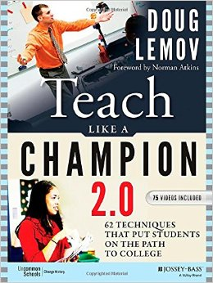

Slide 14
A process you can replicate

Slide 15
Example

Slide 16
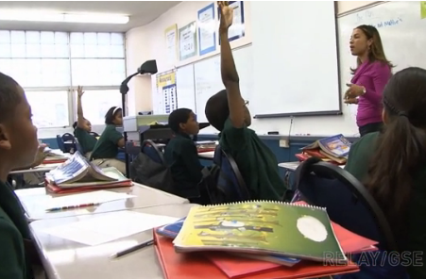
Jessica Bracey
Why are Jessica’s kids so engaged?

Slide 17
The Ratio Spectrum
100% TR
The Goal
Think Ratio: How deep is the thinking?
100% PR
Participation Ratio: How many are participating?
Notes:
Example Activities that Drive PR:
Everyone offers to participate; everyone answers; everyone does the written work; everyone actively listens
Example Activities that Drive TR:
Students refine previous ideas; develop new ideas; translate ideas into written format; use ideas in a new setting
The goal is to have 100% in both PR and TR

Slide 18
Notes on Building Ratio “Participating” is not just talking. Writing, listening and reading are at least as important. When students write, everyone answers the question. If you write before you discuss, more students can participate and they will likely have better answers. And they can listen to one another.

Slide 19
Jessica Bracey
How does watching ‘game film’ of classrooms like Jessica’s help develop teachers?

Slide 20
How does watching ‘game film’ of classrooms like Jessica’s help develop teachers?
Existence proof
How to make it work
Real world issues
Related factors
Reinforce decision-making & perception
Shared inquiry

Slide 21
Why Else to Find & Study Champions

Slide 22
Know What Works…and How

Slide 23
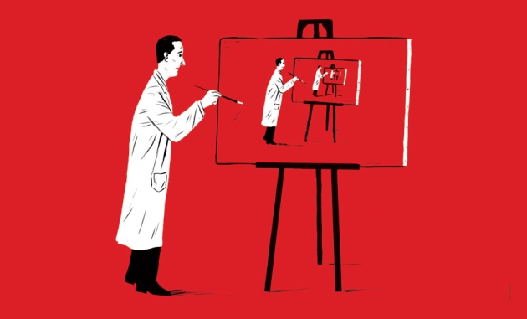
Replicating What Works v Fixing What’s Broken

Slide 24
Respect and Appreciation=Retention

Slide 25
Cultural Capital
Notes:
Consider also the other teachers in her school, where the failure rate is 50%!!!
Consider the teachers in all the other schools…
What other profession fails at that rate???

Slide 26
For Example
There is no achievement gap that some teacher, somewhere has not closed. We just need to find her and study her.

Slide 27
People Worry About Buckets

Slide 28
The Top Matters Most

Slide 29
Example

Slide 30
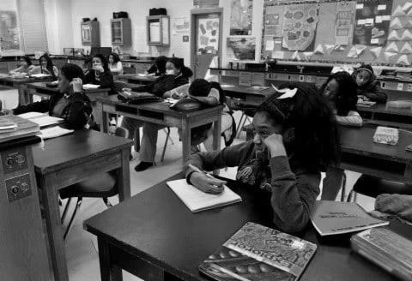
Scene From the Life of a Teacher

Slide 31
We Live in Fear of Crickets

Slide 32
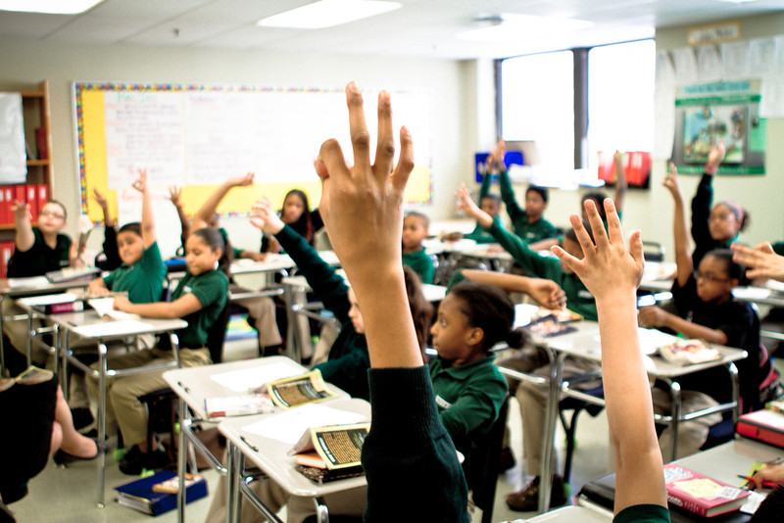
Solutions
Cold Call
Turn and Talk
Everybody Writes
Wait Time

Slide 33
Jon Bogard Na’Jee Carter
How does each teacher emphasize the positivity of Cold Calling?
Notes:
EA.ColdCall.GR9.Bogard.‘In your mind.’Clip1616
EA.ColdCall.GR2.Carter.'Cold Call montage.'Clip2419
________________________________________
EA.ColdCall.GR9.Bogard.‘In your mind.’Clip1616
Context: In this clip, Jon Bogard, a high school science teacher at Sci Academy in New Orleans reviews finding the area of a rectangle that has sides that are comprised of algebraic equations. It is clear from the beginning that his students are used to being Cold Called, and are ready to answer his questions.
Positive:
The playfulness of his use of Feign Ignorance sets the mood for his Cold Call. It’s not punitive or laborious—it’s intended to be fun, gamelike, and inviting.
Notice Jon’s positive phrases that contribute to his warm tone, “that is exactly right” and “you guys are FOIL champions, I don’t want to waste your time by doing that…Anj what did you get?” John seamlessly Cold Calls his students after a quick empowering compliments.
Jon also keeps student engagement up when he feigns ignorance. His students correct him, and doing this little gesture indicates that Jon is willing to turn the table on his students and let them correct him, and right after the class says he is wrong, Jon cold calls Terry to fix his problem.
Kids snap for/celebrate peers when they get the answers right. Jon has anticipated in advance what could go wrong with Cold Call and has pre-taught them to snap for them if they’re doing something well and if they’re struggling, then send him some magic.
Unbundled:
Jon Cold Calls his students by first asking them to provide basic information about the irregular rectangle (what are the dimensions, what is the other piece of information?). Notice how John’s questions build on one another from the beginning. He is very systematic, and his questioning is able to outline very clearly for his students how to approach the problem.
Unbundling also helps Jon build up to greater rigor. He first begins with questions that are answered directly in the problem to those that are more challenging. Note the way he gives students longer Wait Time for those.
Additional Points:
After determining the dimensions of the rectangle, Jon asks his students how to find the area of a rectangle like this. This is a trickier question, so Jon gives his students Wait Time, and asks Chelsea to answer the question. It’s important to note that when he says, “your hand was up in your mind” Chelsea’s hand was already up; this is not a Cold Call.
The clip ends with Tevin trying to find the width of the figure, Jon’s classroom has a positive culture in which students are able to freely offer an answer and take risks even if they are wrong (they are helping him out, and giving him “magic”). Jon doesn’t give Tevin the answer, but leads him to the correct one through his questioning.
EA.ColdCall.GR2.Carter.'Cold Call montage.'Clip2419
Context: In this clip we see Na’Jee Carter, second grade teacher at North Star Academy, lead a discussion with his guided reading group.
Predictable & Systematic: Students are not jarred or surprised when they called on in Najee’s class. They know that they could be called on at any moment and are ready to share their knowledge with their peers. Na’Jee’s cold calling is predictable because it’s systematic. Every student knows that he may call on them at any moment to share their ideas. This also helps support checking for understanding during this discussion on conflict and the characters.
Positive: Na’Jee shows warmth in his facial expression during his cold calling to keep it positive, rather than making it feel like a “gotcha” moment. He infuses positive, conversational phrases like, “Marcell, talk to me” to make his questioning feel more like a regular conversation about the details of the lesson.

Slide 34
Here are some of Na’jee’s prompts in Cold Calling. What do you notice? How do they build positive culture?
“Marcel talk to me.”
“Tell me about the internal conflict, Yedidio.”
“Can you tell me about that conflict, Marcel?”
“Yedidio I want you to start to speak about what kind of conflict you see.”

Slide 35
Houston: Cold Call? We Can Do That

Slide 36
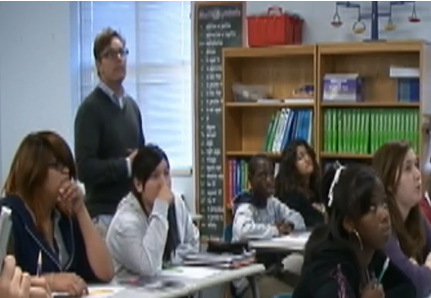
Gary Lauderdale
What has Gary kept? What has he adapted?
Notes:
EA.ColdCall.GR6.Lauderdale.'I saw a lot of thought.'Clip0655
Gary Lauderdale reviews a series of math problems by Cold Calling his students.
This clip starts with Gary Working the Clock and counting down the time to signal the end of work time. Gary then gives some Precise Praise and thanks his students for their thought and effort.
Gary then Cold Calls his students to review the work the students have just completed. Notice how Gary asks the students to build on each other through his use of Follow-on Cold Calls.
Gary warm, supportive tone which reinforces a strong Culture of Error. His words and actions show them that he values effort and the learning that comes from making mistakes. Gary is very positive with his students, he says, “I see a lot of good work so I know we’re going to be successful.”
Additionally, notice that several of his Cold Calls questions ask the students to identify the Next Step in solving the problem. Gary also does most of his Cold Calls from the back of the classroom with student facing the board. This ensures that the students aren’t focusing on him and whether they’ll be called on, but rather they are focused on the math that’s on the board.
His Cold Call is systemic, even if he has a “tell”, his students can’t see it because he’s behind them. Also note how the sheer quantity of his Cold Calls illustrates how systematic he is about Cold Calling.
The students are used to his routine of Cold Calling; they’re all ready to answer on the spot.

Slide 37
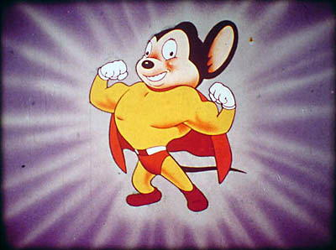

Slide 38
Wait Time
On average, a teacher waits less than one second before taking an answer. What impact does this have on students?
Notes:
You don’t get the highest quality answers
You socialize the opposite of what you want which is thought and reflection. Instead you socialize surface thinking and answers
More reluctant students shirk back
Overheard at workshop:
Becomes a speed game
Discourages some students from participating because it’s a speed game
Response won’t be rigorous if you don’t let kids think

Slide 39
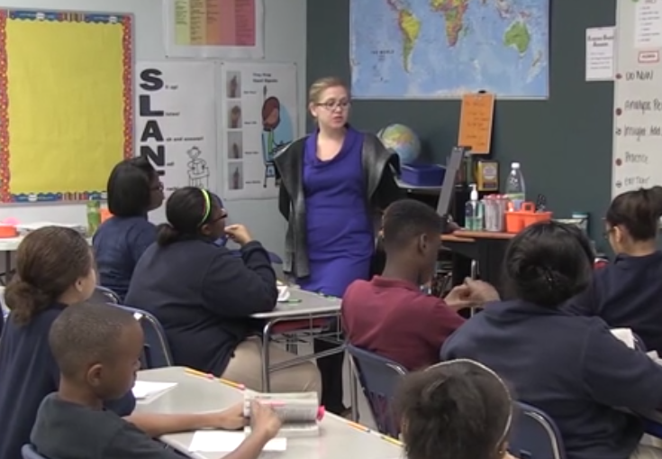
Maggie Johnson
Observe Maggie’s students during Wait Time.
But watch again and watch Maggie. The how is as important as the what.
Notes:
STOP ACTION
EA.WaitTime.GR8.Johnson.’Focus on why.’Clip2017
Facilitation: Play it once, ask for a few observations. Play it again and pause twice. First in the first cut right after the girl’s hand goes up. Second in the second cut and point out the girl in the front who wavers with their hand. Each of these students could be considered archetypes of students – the student who doesn’t spend much time thinking and the more cautious student who finally decides to take a risk. Both of these types of students benefit from wait time.
Context: In this clip, Maggie Johnson, and 8th grade reading teacher at Troy Prep Middle School in Upstate New York, facilitates a discussion about a section of text from the novel the class is reading: To Kill a Mockingbird. She uses Wait Time to give students time to process her question and to foster motivation and enthusiasm to participate. It also encourages students to engage in deep thinking during a discussion.
Stop Action Notes:
Stop #1: 0:14 – Girl hand shoots up right away
“Her hand is up and Maggie hasn't even finished the question! How many people have a kid like this? What's she going to say? (Call out answers)
“Maggie has barely finished her question and this girl’s hand has already shot up. If she calls on her then no one else has the chance to even engage with the question – shutting down both PR and TR. Watch what she does instead. (scans and smiles and waits 9 seconds)
Stop #2 0:32 – “This boy’s hand never even went down. Why is that a problem?”
Stop #3 0:37 – “Watch this girl in the front row. And consider the impact of WT on her. And other students like her.”
Cut 1:
Maggie waits approximately five seconds after asking her question and taking a hand.
Soon after she asks the question, she scans the room and raises her eyebrows and smiles. This bit of inviting warmth motivates even more students to participate.
The result: Within four seconds, we see eight students’ hands go up
Cut 2:
Maggie uses even longer Wait Time (12 seconds) before taking a hand.
Note that Maggie strategically moves to “Pastore’s Perch” (right-hand corner of her room). This makes it easier for her to see students whose hands go up and for those students to see her looking for their hands as well. She then uses an obvious scan to draw attention to the fact that she’s looking, which enhances the accountability.
Note that she also uses the Wait Time as an opportunity to reinforce academic skills: “Great. And if you’re looking in your book, make sure you pause and track Arshe.” In doing so, she reinforces the expectation that students should track peers during discussion and encourages more students to revisit the text.
The result: several students eagerly raise their hands to participate.
Cut 3:
Maggie waits eight seconds before taking a hand.
During her Wait Time, she again moves to “Pastore’s Perch” and uses a swivel (or left-to-right turn of her head) to ensure she is Seen Looking for raised hands.
Again, she warmly invites students into the discussion by smiling and raising her eyebrows as she looks around.
The result: nine students’ hands shoot up
Talking Point Addition/s:
DL: Go from one person answers the question to everyone answers the question (in those 12 seconds) and one person says their answer aloud.

Slide 40
Last Thought on Technique

Slide 41
A Final Reflection on Teaching
Insert Kesete
What makes Kesete effective?
Notes:
New point: “The subtle difference between a culture of high expectations that comes with love and a culture of high expectations that comes with frustration and anger.”
One of the things that we think about culture is intangible. What I’m watching here the mundane day to day interactions.
Personality is technique in disguise.
Technique builds personality and vice versa
“What we attribute to personality is often technique in disguise. Technique makes it possible to be the person you want to be in the classroom.”
This isn’t accurate but some pieces of it were, “The struggles to manage the daily struggles of the cross that determines whether you stay with the job…
“Tiny changes don’t just shape your classroom. They shape you. Technique is personality.” “That’s why you should obsess on the details of Strong Voice.”
“The subtle difference between a culture of high expectations that comes with love and a culture of high expectations that comes with frustration and anger.”
Shareout from group
He had a nice blend of firm and flexible. Back and forth between expectation setting and warm and caring.
What was most important is what you couldn’t see. You can tell he has a great knowledge of students. He knew what to say to each student in their own circumstance.
Kasete has a personalized connection with each student. He seemed to have some deep connection with each student.
He’s there, visible, greeting kids, in the place where the action happens instead of the halls
DL-it’s so important to be out there preemtively in the mundane moments in our lives. Also where he is, he’s in the perfect place. He’s so close where he’s able to touch the student, but when Kasete resets the kid by placing his hand on his elbows. He’s set expectations by using positive contact. Even his body language communicates that. That to us is technique. This is what we’re talking about over the next few days.
Did anyone talk about personality? Find me a person who doesn’t want to be like Kasete, who wants to stand at the top of the stairs and believe in them, and push them to work a little bit harder every day. The thing that keeps people from being that is technique. Technique enables perwsonality. The reason why people don’t do this is they haven’t figured out how to interact with a kid comin gup the stairs. They’re too nervous to interact with tht kid coming up the stairs. The teaching persona that you want to be is shaped by your technique.
I thought about this as a parent, I got home and my son had done something, and I wasn’t clear if he wasn’t supposed to do it, and so I snapped at him, and he snapped back at me and I got mad at him, and we got into a mini-argument. I wasn’t the parent I wanted to be because my technique wasn’t good. That’s an analogy in the classroom.
Personality does matter, but technique matters more. E.g. if I had thought about something t I thought about in my

Slide 42
A Final Reflection on Teaching
Insert Kesete
“Relationships” are often technique in disguise.
Notes:
New point: “The subtle difference between a culture of high expectations that comes with love and a culture of high expectations that comes with frustration and anger.”
One of the things that we think about culture is intangible. What I’m watching here the mundane day to day interactions.
Personality is technique in disguise.
Technique builds personality and vice versa
“What we attribute to personality is often technique in disguise. Technique makes it possible to be the person you want to be in the classroom.”
This isn’t accurate but some pieces of it were, “The struggles to manage the daily struggles of the cross that determines whether you stay with the job…
“Tiny changes don’t just shape your classroom. They shape you. Technique is personality.” “That’s why you should obsess on the details of Strong Voice.”
Shareout from group
He had a nice blend of firm and flexible. Back and forth between expectation setting and warm and caring.
What was most important is what you couldn’t see. You can tell he has a great knowledge of students. He knew what to say to each student in their own circumstance.
Kasete has a personalized connection with each student. He seemed to have some deep connection with each student.
He’s there, visible, greeting kids, in the place where the action happens instead of the halls
DL-it’s so important to be out there preemtively in the mundane moments in our lives. Also where he is, he’s in the perfect place. He’s so close where he’s able to touch the student, but when Kasete resets the kid by placing his hand on his elbows. He’s set expectations by using positive contact. Even his body language communicates that. That to us is technique. This is what we’re talking about over the next few days.
Did anyone talk about personality? Find me a person who doesn’t want to be like Kasete, who wants to stand at the top of the stairs and believe in them, and push them to work a little bit harder every day. The thing that keeps people from being that is technique. Technique enables perwsonality. The reason why people don’t do this is they haven’t figured out how to interact with a kid comin gup the stairs. They’re too nervous to interact with tht kid coming up the stairs. The teaching persona that you want to be is shaped by your technique.
I thought about this as a parent, I got home and my son had done something, and I wasn’t clear if he wasn’t supposed to do it, and so I snapped at him, and he snapped back at me and I got mad at him, and we got into a mini-argument. I wasn’t the parent I wanted to be because my technique wasn’t good. That’s an analogy in the classroom.
Personality does matter, but technique matters more. E.g. if I had thought about something t I thought about in my

Slide 43
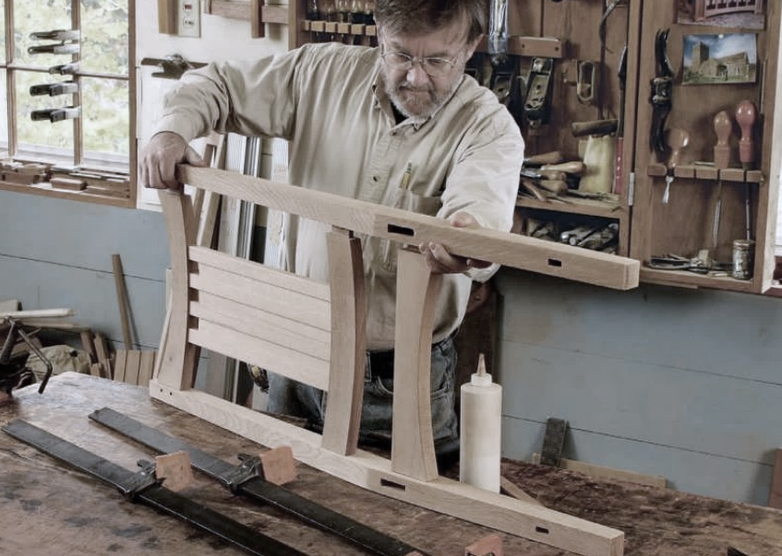
Craftsmanship
Art
Science

Slide 44
What Else Teachers Need
Supportive Culture
Shared Vocabulary
Practice
Flexibility

Slide 45
Culture

Slide 46
Katie Bellucci
What inspires you about the culture Katie is building in her classroom? How does it lead to student learning and achievement?

Slide 47
Culture of Error
We describe a classroom where students feel safe exposing their errors to their teacher in the faith and trust that doing so will have a positive outcome as having a “Culture of Error.” When this occurs Checking for Understanding is 10x easier. So is learning.

Slide 48
This also applies to the teachers in the building. When you acknowledge and expose the struggle, when it is understood that the only way to be great is to make and learn from errors, and when teachers feel this, getting them better is 10x easier.

Slide 49
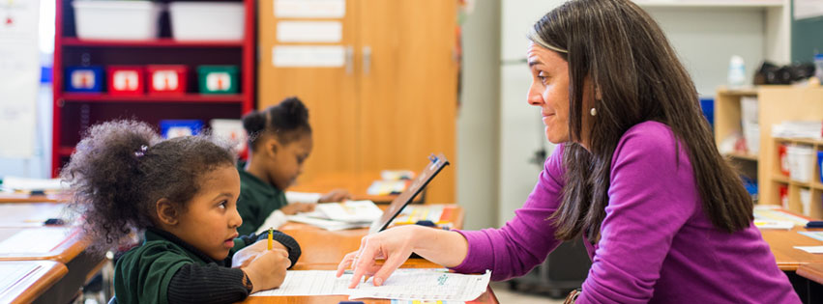
A Happy Story
Which is the Cure; Which is the Placebo?

Slide 50
A Happy Story
Which is the Cure; Which is the Placebo?
What would it take for this to happen in your school(s)?

Slide 51
Most Teacher Training is Not Very Good

Slide 52
Most Teacher Training is Not Very Good
But it costs about 1/3 of a typical teacher’s salary. Per teacher. Per year. Every year.

Slide 53
Success is About (Adult) Culture

Slide 54
Shared Vocabulary

Slide 55
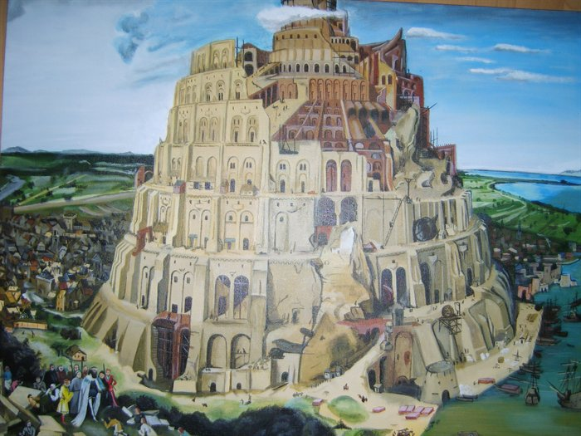
Notes:
And we know that because like most things we know that are worthwhile we learned them from our teachers. They met our kids and came to us and said: Our schools are good. But good isn’t good enough. Make us great. We wanted to honor our teachers by doing that for them. We OWED them that. And we knew we couldn’t. SO…

Slide 56
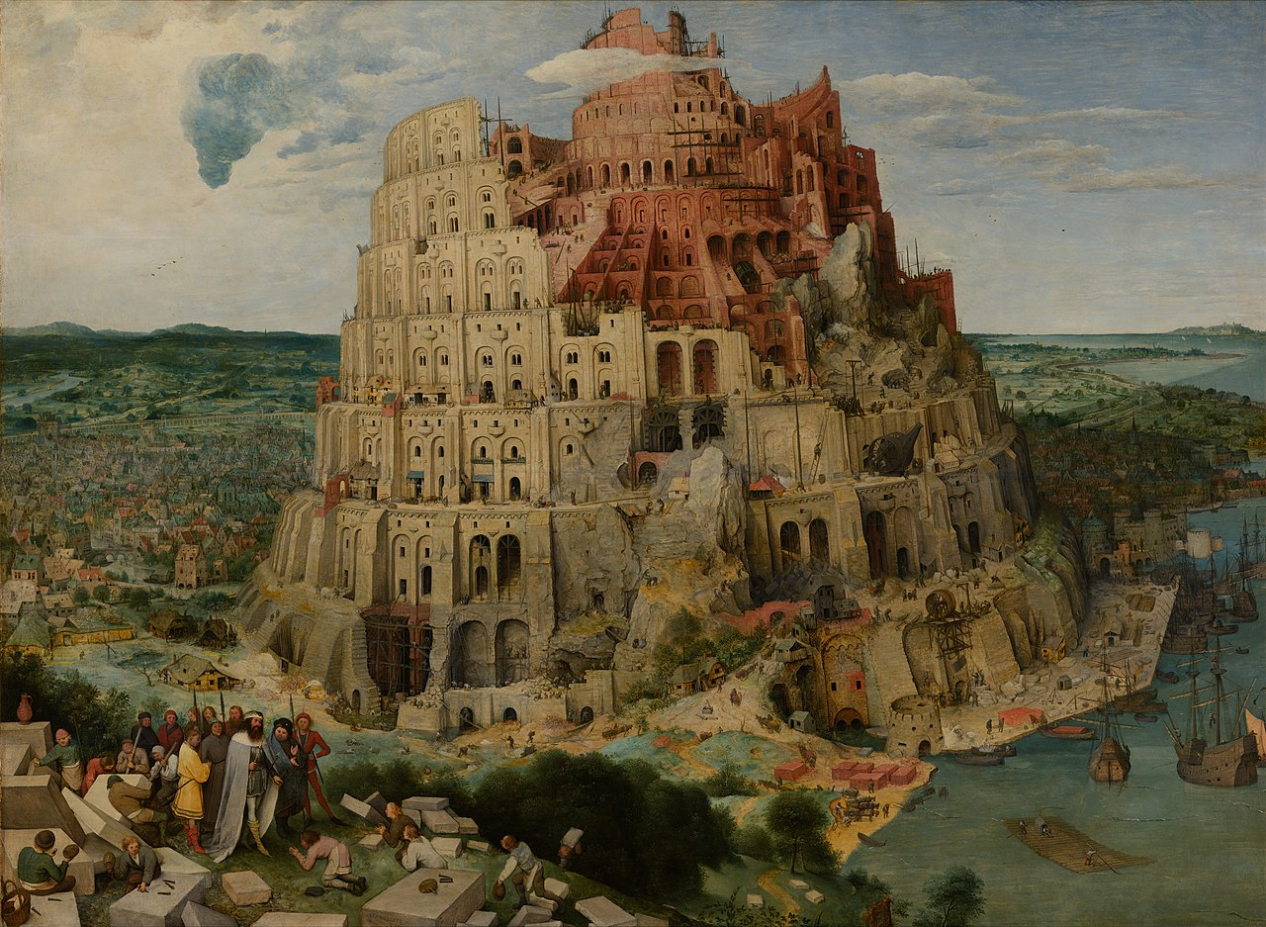
PLACEHOLDER FOR INTRO SLIDES
Theme: Oil and Water
At First:
And the whole earth was of one language, and of one speech. “Behold, the people is one, and they have all one language; and now nothing will be restrained from them, which they have imagined to do.”
And Then:
People used the power to build a tower to heaven to show how great they were.
The Lesson:
The LORD did there confound the language of all the earth: and from thence did the LORD scatter them abroad upon the face of all the earth.
Data from Icahn and Success
Intro Framing:
This may familiar for many of you but we want to make sure we have a shared base of knowledge.
-Define key terms
-Shared texts/videos
-Role of knowledge in Ratio
-Wearing your IL hat
- Because it’s simple and familiar doesn’t mean it’s not critical.
Notes:
If you remember the story of ToB in the bible …..read the slide….because they had shared vocabulary….but they got a little carried away and built a tower to heaven so he removed the shared language. The story here is about the power of shared vocabulary. When we have it, we can build towers to the sky.

Slide 57
Practice

Slide 58
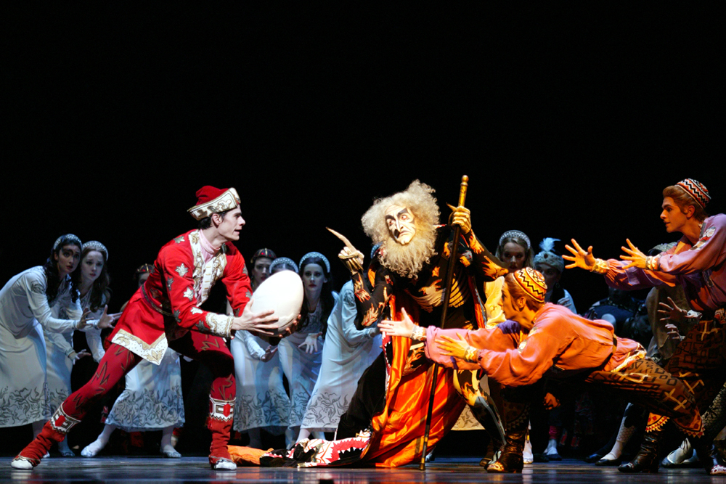
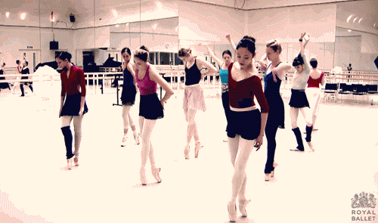
Practice: Because Teachers ‘Go Live”

Slide 59
Art Worrell & Matt Cheeley
Notes:
1=roberts
2=jacobi and hilary
3=juliana and clare***
3 first.
Then 1
Then 2

Slide 60
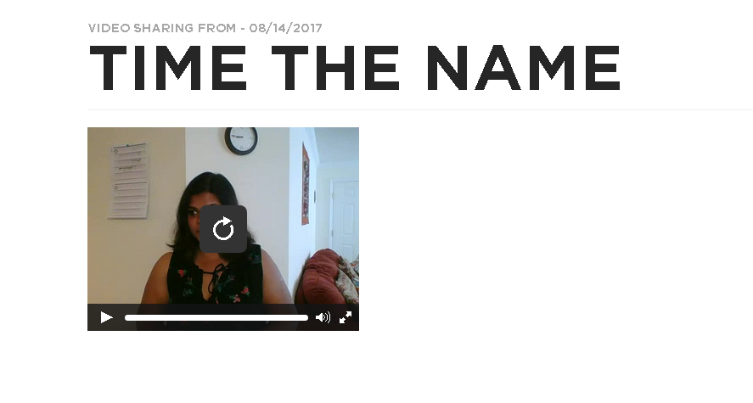
TLaC Online
∆
Notes:
You don’t get the highest quality answers
You socialize the opposite of what you want which is thought and reflection. Instead you socialize surface thinking and answers
More reluctant students shirk back
Overheard at workshop:
Becomes a speed game
Discourages some students from participating because it’s a speed game
Response won’t be rigorous if you don’t let kids think

Slide 61
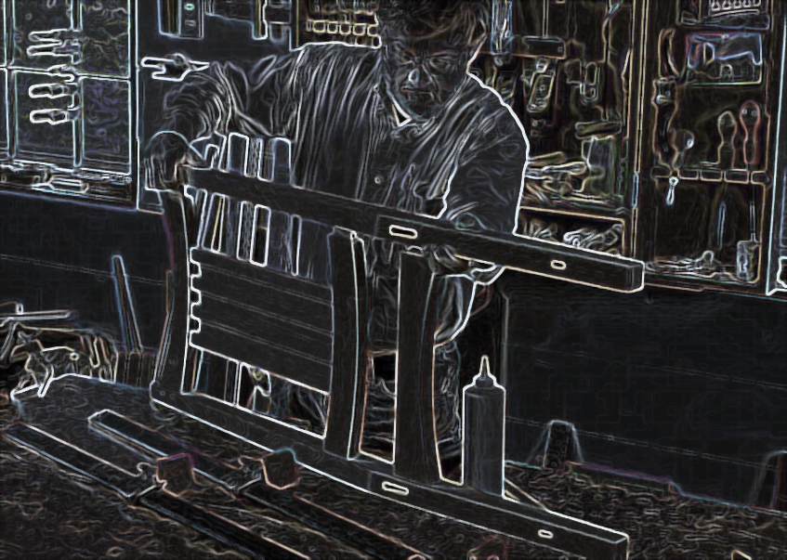
Craftsmanship
Art
Science

Slide 62
Flexibility

Slide 63
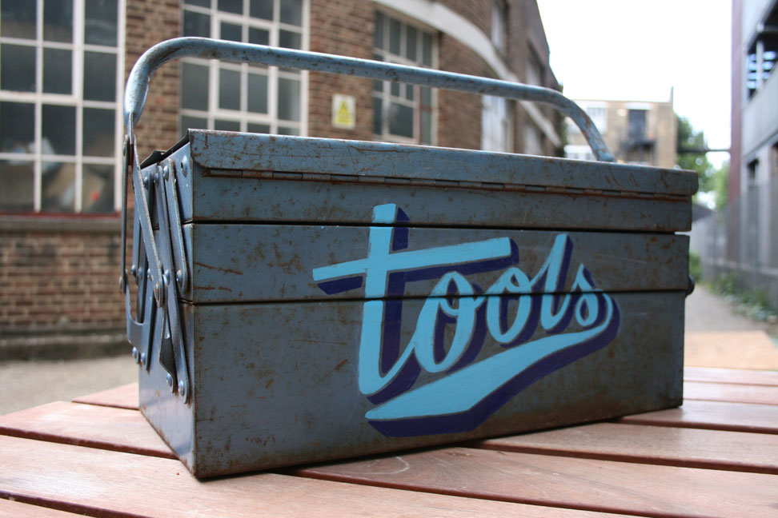
Go All In

Slide 64
Theme and Variation
∆

Slide 65
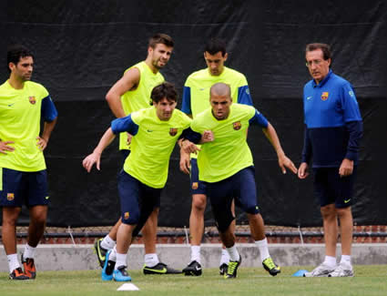
Effective PD—A Checklist
Tools for craftsmen/women to use to solve problems
Embedded in school culture/operating systems
Sustained conversation vs. “one-and-done”
Based on what the best among us really do (w game film)
With and by teachers as much as ‘at’ them
Solving “real world” challenges
For teachers at all skill levels, especially high performers. (PD is not a pejorative)
Practice + Planning + Content Knowledge
Where it’s safe to struggle and learn
Notes:
DL
Houston has bright spots too

Slide 66
@Doug_Lemov teachlikeachampion.com/blog

Slide 67
A Story
Notes:
I’d like to start by telling you a story. A tale of heroism and danger. But it’s not a bedtime story. Please don’t fall asleep

Slide 68
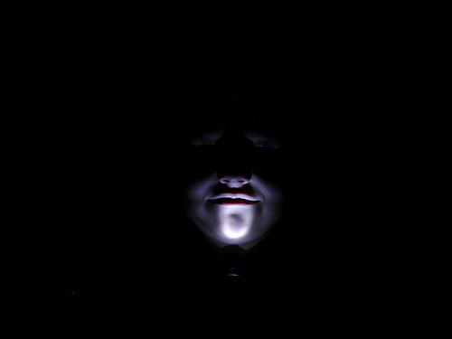
Caution: This is a Scary Story
Notes:
Now I should tell you that in many ways this is a very scary story. I want to warn you. It’s scary because the district had known this information about teachers like Zenaida for years. AND THEY HAD NEVER DONE ANYTHING WITH IT. The newspaper had to FOIL it. But who can blame them. They were essentially prevented from managing it. Who wants to know about information you can’t use?
But it’s also scary because no one else had ever been to visit Zenaida Tan before. And we’ll come back in a minute to why it’s so scary.

Slide 69
Notes:
It’s the story of this woman who of course you don’t know. She is almost completely anonymous. But it is also the story of thousands of people like her. Her name is Zenaida Tan. She is from the land of heroes, villains and monsters. By which I mean, of course, Los Angeles.

Slide 70
Notes:
The Los Angeles Times used LAUSD’s value-added data to find the most exemplary teachers in the district over years and years. The students in these teachers’ classrooms made, in some cases over two to three times the yearly progress that they did with other teachers and they did this year after year. A Zenaida Tan was one of them. So the LA Times went to see her.

Slide 71
LA Unified School District has hundreds of teachers who preside over remarkable successes, year after year, often against incredible odds. But…most are like Zenaida Tan, working in obscurity. No one asks them their secrets. Most of the time, no one even says, "Good job." Often even their own colleagues and principals don't know who they are.
Tan brims with effective ways to reach limited-English students, handle discipline problems and keep the kids engaged. "I do a lot of singing, games," she said. "It doesn't look like a lesson."

Slide 72
But no one asks for her advice. She says her fellow teachers at Morningside consider her strict, even mean. She tends to keep to herself. "Nobody tells me that I'm a strong teacher," she says. That's OK by her, she adds. Year after year, she watches her students make enormous progress and feels a quiet sense of satisfaction.
By LAUSD's measure, Tan "meets standard performance," as virtually all district teachers do -- evaluators' only other option is "below standard performance."

Slide 73
On a recent evaluation, her principal checked off all the appropriate boxes, Tan said -- then noted that she had been late to pick up her students from recess three times. "I threw it away because I got upset," Tan said. "Why don't you focus on my teaching?! Why don't you focus on where my students are?“

Slide 74
What’s So Scary?
Notes:
Like to start by telling you a story. A tale of heroism and danger. Not a bedtime story. Please don’t fall asleep

Slide 75
A Failure to Support & Develop Her
Notes:
Consider the evaluations system LASD uses. Designed to if not make teachers better help validate and value them. Or differentiate successful ones.
But this system drove her out of the system, mis-indentified her and failed to make her better

Slide 76
Aidan Thomas
What can you observe about how, why, and when Aidan uses the different types of Wait Time we discussed?
Notes:
EA.WaitTime.GR6.Nathan.'How fast.'Clip2235
Context: In this clip, Danielle Nathan, a 6th grade math teacher at Brooke East Boston Charter School, intersperses her lesson on finding unit rates with Wait Time to boost Participation Ratio and Think Ratio. Note to facilitator: this montage features three Wait Time moments.
Cut #1:
Immediately after she calls on a student to analyze a peer’s Show Called work, she then gives the class sufficient Wait Time to process and evaluate the student’s analysis. In doing so, she not only ups Participation and Think Ratio, she also socializes students to listen carefully to their peer’s contributions during discussions.
Note the way she moves to Pastore’s Perch (corner of the room) as she visibly scans the classroom for hands. This makes it easier for her to see whose hands are going up and for students to see her looking for hands.
She then adds a warm, inviting smile to acknowledge the hands that she sees go up and to invite even more participation.
Note how Danielle moves at a slow, stately pace as she looks around the room. This signals to students that they should be thinking deeply during Wait Time.
Cut #2:
After Danielle asks the class to evaluate Sophia’s Show Called work, she swivels her head to ensure she is Seen Looking for hands. We then see several go up.
Danielle’s slow, subtle movements signal to students that she wants them to be thinking deeply.
Even after she gets about 70-80% of hands to go up, she holds out for that last 20-30% to raise their hands. In doing so, she sets a high standard for participation while also giving every student enough time to truly consider her question.
Note that in this cut, the student she calls is the last student to raise a hand.
Cut #3:
After asking a question, Danielle again moves to Pastore’s Perch and slowly swivels her head to scan the room for hands. In doing so, she ensures she is Seen Looking for hands.
We see some students use the Wait Time to refer back to their notes, which promotes deeper thinking and a higher quality response.

