Slide 1

Introductory Training on the
Proficiency Level Descriptors (PLDs)
Grades 2–12
2021-2022
Texas Education Agency
Student Assessment Division
Notes:
This presentation is intended to be used after the Making the ELPS–TELPAS Connection: Grades K–12 Overview, which may be accessed from TEA’s TELPAS Resources webpage.
To make best use of this PowerPoint module, print the ELPS-TELPAS Proficiency Level Descriptors (PLDs) found on the TELPAS Resources webpage.
These PowerPoint resources, plus the TEA publication, TELPAS and TELPAS Alternate Educator Guide, are provided to support the effective use of the ELPS during instruction and assessment.
Note that abbreviated, reformatted, or modified proficiency level descriptors must not be used in training raters or assessing students. In support of standardization, the PLDs must be used as they have been formatted and published for TELPAS.

Slide 2


Proficiency Level Descriptors (PLDs)
The PLDs are the rubrics teachers use to determine students’ English language proficiency for ongoing formative assessment and the spring TELPAS administration.
Originally developed for TELPAS, the PLDs were incorporated into the Texas English language proficiency standards (ELPS) in the 2007-2008 school year to reinforce their use in instruction.
Notes:
The TELPAS holistically-rated assessments were developed by TEA in collaboration with test development contractors, bilingual/ESL consultants, and a focus group of teachers, bilingual/ESL coordinators, test coordinators, and university professors.
The design of the assessments derives from the following language acquisition research and research-based standards, models, and assessments:
second language acquisition research of Jim Cummins concerning the
development of BICS and CALP
TESOL (Teachers of English to Speakers of Other Languages) ESL
standards
ACTFL (American Council for the Teaching of Foreign Languages)
proficiency guidelines and the ACTFL Performance Guidelines for K–12
Learners used in Texas LOTE (languages other than English) programs
similar assessment strategies used in other states

Slide 3
6 Sets of PLDs
Listening Grades K–12
Speaking Grades K–12
Reading Grades K–1
Grades 2–12
Writing Grades K–1
        Grades 2–12
Notes:
In alignment with the ELPS, TELPAS evaluates English language acquisition as it relates to grade-level expectations for understanding and using English to meaningfully engage in content area instruction.
The sets of PLDs are often referred to as rubrics for purposes of TELPAS. There is one K–12 rubric for listening and one K–12 rubric for speaking. K-1 raters consider a student’s listening and speaking proficiency levels in relation to the typical listening and speaking abilities of native English speakers at the student’s grade level.
For grades 2-12, teachers use the listening and speaking PLDs in instruction but not for TELPAS, because TELPAS has an online test with a variety of item types for these grades.
For reading and writing, there are separate rubrics for K–1. The K–1 rubrics are distinct because factors associated with emergent literacy distinguish K–1 learners from students in higher grades.
For grades 2–12, teachers use the reading PLDs in instruction but not for TELPAS, because TELPAS has a multiple-choice test for these grades.
English learners (ELs) receiving special education services should be evaluated relative to their ability to understand and use English to access the general curriculum at their enrolled grade in accordance with their individualized educational program (IEP). This assessment guideline aligns with federal requirements for ensuring that students with disabilities have access to the general curriculum. For ELs with the most significant cognitive disabilities, please refer to the TEA’s TELPAS Alternate Resources webpage for more information.

Slide 4
Key Features of Each Proficiency Level
Beginning
  Little or no English ability
Intermediate
  Limited ability, simple language structures,
  high-frequency vocabulary, routine contexts
Advanced
  Grade appropriate, with second language acquisition support
Advanced High
  Grade appropriate, with minimal second language acquisition support
Notes:
This slide summarizes key features of the PLDs in terms of how well ELs can understand and/or use English in social and academic settings at each of the four levels. These key features are emphasized in the PLD summary statements for each language domain. As an example, refer to the summary statements at the top of the PLDs for listening.
Note the term second language acquisition support. This term refers to the language assistance ELs need as they learn English. It is different from the type of assistance that any student (whether an EL or not) might need when learning academic content. Second language acquisition support is specific to the unique language assistance that ELs need.
The overall language abilities of each proficiency level are as follows:
Beginning students have little or no ability to understand/use English. They may know a little English but not enough to function meaningfully in social and academic interactions.
Intermediate students do have some ability to understand and use English. They can function in social and academic settings as long as tasks require them to understand and use simple language structures and high-frequency vocabulary within routine contexts.
Advanced students are able to engage in grade-appropriate academic instruction in English, although ongoing second language acquisition support is needed to help them understand and use grade-appropriate language. These students function beyond the level of simple, routinely used English.
Advanced high students have attained the command of English that enables them, with minimal second language acquisition support, to engage in regular, all-English academic instruction at their grade level.
Note that high academic achievement is not a prerequisite of the advanced high level of English language proficiency. Advanced high ELs exhibit a range of academic achievement just as their native English-speaking peers do.

Slide 5
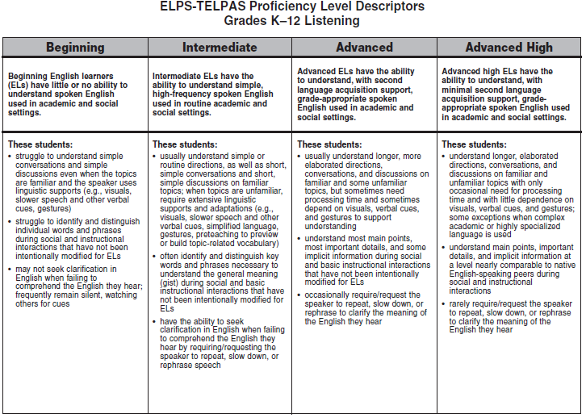
ELPS-TELPAS Proficiency Level Descriptors
Grades K–12 Listening
Notes:
The PLDs for each language domain present a set of major attributes associated with each level. The descriptors do not constitute an exhaustive list but are sufficient for identifying students’ stages of English language proficiency. Together, the summary statement and bulleted descriptors for each proficiency level form a student profile.
Review the full-size listening PLDs and note the overall English communication abilities described in the summary statement for each level.
B little or no English
I simple, high-frequency, routine
A grade-appropriate with second language acquisition support
AH grade-appropriate with minimal second language acquisition support
Examine the main features of each level. Note how the descriptors further define the summary statements and show the continuum of English language development across the proficiency levels.
1st descriptor: type of spoken English understood and extent to which understanding is dependent on supports and linguistic adaptations
2nd descriptor: degree of comprehension demonstrated when interactions are not modified to include supports and linguistic adaptations
3rd descriptor: degree of need to seek clarification to understand or confirm meaning of spoken English
In the context of second language acquisition, the term “high-frequency words” refers to commonly encountered words that a student who knows very little English can be made to understand through context, gestures, and pictures. Initially, the kinds of high-frequency words and phrases typically acquired may include, for example, greetings, numbers, objects in the classroom and around school, names of classmates, etc.
When rating a student, read each proficiency level as a whole (i.e., the whole vertical column as opposed to isolated descriptors) and determine the level that best describes the student’s current, overall level of English language acquisition.

Slide 6
Reflect on how well the student understands the English he or she hears during activities such as:
Reacting to oral presentations
Responding to text read aloud
Following directions
Cooperative group work
Informal interactions with peers
Large-group and small-group instructional interactions
One-on-one interviews
Individual student conferences
Notes:
This list of activities is not exhaustive. Teachers may identify other appropriate activities suited to the grade level(s) taught.
Think about what behaviors help indicate an EL’s level of English language listening proficiency and how to tell whether an EL is struggling to understand the English used in oral presentations, directions, text read aloud, etc.
For grades 2-12, teachers use the listening PLDs for instructional purposes, but not for TELPAS. The domain of listening is assessed online.

Slide 7
Beginning Listener
Nonacademic Listening Sample
What Might a Beginning Listener Understand?
I have some exciting news for you today. We are going to be going on a field trip next week. On Thursday after the announcements, we will load the buses and be gone the entire day. In order to be permitted to go, you must have your parents read and sign this permission slip. If your parents would like to chaperone, there is a place on the form for them to volunteer. Please put this in your backpack to take home tonight. Remember, you have to bring it back signed or you will not be able to go with us.
Text in bold, red print represents text that might be understood.
Notes:
This sample shows classroom speech that is not academic in nature. In each listening sample presented in the upcoming slides, it should be assumed that the teacher is talking informally to a class without making linguistic accommodations designed for ELs.
In spontaneous informal speech, ELs who have learned a little English may hear some individual high-frequency words that they will be able to distinguish in highly routine classroom situations (today, buses, school, go, etc.); however, they cannot understand enough English to make sense of spoken messages delivered at a normal speed and without linguistic accommodations.
This sample exemplifies what is meant by the second beginning bullet of the PLDs for listening.
Beginning listeners:
struggle to identify and distinguish individual words and phrases during social and instructional interactions that have not been intentionally modified for ELs
These listening samples reinforce the importance of making appropriate linguistic accommodations according to the EL’s proficiency level.
Beginners can be expected to struggle to understand what they hear even when extensive linguistic accommodations (adaptations and supports) are provided. Beginners benefit most from having a teacher or peer translate what is said into their native language.

Slide 8
In Other Words (Beginning Listener)
… today. We are going … Thursday … buses … day … go … parents … parents … like … Please … backpack … home … go …
Notes:
While this beginning student understands some very high-frequency words and phrases in English, the student is not able to make sense of the message the teacher is conveying to the class.

Slide 9
Intermediate Listener
Nonacademic Listening Sample
What Might an Intermediate Listener Understand?
I have some exciting news for you today. We are going to be going on a field trip next week. On Thursday after the announcements, we will load the buses and be gone the entire day. In order to be permitted to go, you must have your parents read and sign this permission slip. If your parents would like to chaperone, there is a place on the form for them to volunteer. Please put this in your backpack to take home tonight. Remember, you have to bring it back signed or you will not be able to go with us.
Notes:
An intermediate listener is able to understand much more of the message than a student at the beginning level. Typically, students at this level are able to understand enough key words and phrases to capture the general meaning or general idea (gist) of the message.
This sample exemplifies what is meant by the second intermediate bullet of the PLDs for listening.
Intermediate listeners:
often identify and distinguish key words and phrases necessary to understand the general meaning (gist) during social and basic instructional interactions that have not been intentionally modified for ELs

Slide 10
In Other Words (Intermediate Listener)
I have … you today. We are going … field trip next week. On Thursday … we will … the buses … day … to go … parents read and sign this … parents … like to … Please put this in your backpack … take home tonight. Remember … bring it … go with us.
Notes:
In this sample, the student is able to understand a number of phrases containing simple, high-frequency words. These phrases (next week, put this in your backpack, take home tonight) are used very routinely in classroom settings, supporting the EL’s ability to make meaning of longer segments of speech. This student understood the basic gist of the message but few of the important details.
Intermediate listeners often require extensive linguistic accommodations to understand more than just the general idea of what they hear in class. As indicated in the PLDs, some listening accommodations include visuals, simplified language, gestures, pre-teaching to preview or build topic-related vocabulary, slower speech, and other verbal cues such as repetition and native language support.

Slide 11
Advanced Listener
Nonacademic Listening Sample
What Might an Advanced Listener Understand?
I have some exciting news for you today. We are going to be going on a field trip next week. On Thursday after the announcements, we will load the buses and be gone the entire day. In order to be permitted to go, you must have your parents read and sign this permission slip. If your parents would like to chaperone, there is a place on the form for them to volunteer. Please put this in your backpack to take home tonight. Remember, you have to bring it back signed or you will not be able to go with us.
Notes:
This sample exemplifies what is meant by the second advanced bullet of the PLDs for listening.
Advanced listeners:
understand most main points, most important details, and some implicit information during social and basic instructional interactions that have not been intentionally modified for ELs
Advanced listeners are usually able to understand the main points and most of the details of this type of speech, even when the message is not linguistically simplified. As shown here, there are still some gaps in understanding unusual constructions and words used in unfamiliar ways.

Slide 12
In Other Words (Advanced Listener)
I have some exciting news for you today. We are going to be going on a field trip next week. On Thursday … we will load the buses and be gone … day … to go, you … have your parents read and sign this permission slip. If your parents would like … there is a place on the form … Please put this in your backpack … take home tonight. Remember … bring it … or you will not … go with us.
Notes:
This student is able to understand the main point of the message and most of the important details (such as the consequence of not bringing the form back) not understood by the intermediate listener. The student doesn’t understand, however, how long the field trip will take and the idea of parents volunteering to go along to help out. Linguistic accommodations help a student at this level fill in these types of gaps.

Slide 13
Advanced High Listener
Nonacademic Listening Sample
What Might an Advanced High Listener Understand?
I have some exciting news for you today. We are going to be going on a field trip next week. On Thursday after the announcements, we will load the buses and be gone the entire day. In order to be permitted to go, you must have your parents read and sign this permission slip. If your parents would like to chaperone, there is a place on the form for them to volunteer. Please put this in your backpack to take home tonight. Remember, you have to bring it back signed or you will not be able to go with us.
Notes:
This sample exemplifies what is meant by the second advanced high bullet of the PLDs for listening.
Advanced high listeners:
understand main points, important details, and implicit information at a level nearly comparable to native English-speaking peers during social and instructional interactions
Advanced high listeners are usually able to understand most words and details in routine spoken messages, even when the messages are not linguistically simplified.
This advanced high student understands that the class will leave after the announcements and be gone the entire day, and the student understands that the permission slip must be brought back signed.
The student does not understand what “chaperone” means and, therefore, doesn’t understand what the parents will be able to volunteer for.
It is important to keep in mind that students at the advanced high level have difficulty understanding certain things they hear, particularly when low-frequency words are used. At the advanced high stage, though, students understand enough of what they hear to need only minimal second language acquisition support to engage meaningfully in academic and social interactions.

Slide 14
Beginning Listener
Academic Listening Sample
What Might a Beginning Listener Understand?
Good morning, class. Today we are going to study something brand new. It’s difficult, so I’m going to need everyone’s undivided attention. Open your books to page one hundred seventy-two. At the top of the page is the word “net.” Today’s lesson is about net. As it says in the definition in your book, in math, net is a two-dimensional model. The net of a cylinder is shown in your textbook. Does everyone see the rectangle and two circles? That’s the net of the cylinder.
Notes:
These next slides show an example of speech that is academic in nature. As with the previous slides, it should be assumed that the teacher is talking to a class without making linguistic accommodations designed for ELs. These slides provide additional examples of what is meant by the second bullet of the PLDs for listening.
This sample shows speech that a student might hear in a math classroom. In teaching students, teachers frequently give certain repeated, highly routine instructions (e.g., open your books to page). Beginning listeners hear such instructions regularly and begin to memorize phrases, even without understanding each of the individual words. Beginning level students also acquire some academic vocabulary that they hear daily in highly predictable contexts.

Slide 15
In Other Words (Beginning Listener)
Good morning … Today … Open your books to page one … top … page … Today’s … book … math … two … book … rectangle … two circles …
Notes:
As shown in this example, the student understands some high-frequency academic words (one, two, rectangle, circles). The understanding of such words in spoken messages is affected by how fast the person is speaking and the emphasis given to the words.
In the example above, a beginning level student accustomed to using a textbook in math class may memorize the phrase “Open your books to page…,” but the student is likely still struggling to learn English words for numbers. When the teacher says “page one hundred seventy-two” at normal speed, the student may hear or understand only part of the number and, therefore, not turn to the correct page in the book.

Slide 16
Intermediate Listener
Academic Listening Sample
What Might an Intermediate Listener Understand?
Good morning, class. Today we are going to study something brand new. It’s difficult, so I’m going to need everyone’s undivided attention. Open your books to page one hundred seventy-two. At the top of the page is the word “net.” Today’s lesson is about net. As it says in the definition in your book, in math, net is a two-dimensional model. The net of a cylinder is shown in your textbook. Does everyone see the rectangle and two circles? That’s the net of the cylinder.
Notes:
An intermediate listener understands more of the routine instructions heard daily in the classroom (today we are going to study, top of the page, today’s lesson) and makes sense of longer segments of speech. While students at this level are usually able to get the general meaning (gist) of routine, nonacademically complex interactions, they struggle to understand academic lessons that have not been linguistically modified.

Slide 17
In Other Words (Intermediate Listener)
Good morning, class. Today we are going to study … It’s difficult … going to need everyone’s … Open your books to page one hundred … top of the page … Today’s lesson … your book, in math … two … cylinder … book … rectangle and two circles … cylinder.
Notes:
This intermediate level student hears and understands familiar content area words such as cylinder, rectangles, and circles. However, the teacher is attempting to teach students about the net of a cylinder. Because this lesson has not been linguistically modified, the student does not understand enough of what the teacher is saying to grasp the idea that the lesson is about a new concept called net.
Note also that even students at the intermediate level struggle to understand strings of numbers (one hundred seventy-two) spoken at normal speed.

Slide 18
Advanced Listener
Academic Listening Sample
What Might an Advanced Listener Understand?
Good morning, class. Today we are going to study something brand new. It’s difficult, so I’m going to need everyone’s undivided attention. Open your books to page one hundred seventy-two. At the top of the page is the word “net.” Today’s lesson is about net. As it says in the definition in your book, in math, net is a two-dimensional model. The net of a cylinder is shown in your textbook. Does everyone see the rectangle and two circles? That’s the net of the cylinder.
Notes:
Advanced level listeners have acquired enough English to understand the English used in discussing familiar academic topics and some unfamiliar topics. This helps them gain more meaning when they learn new academic concepts. However, advanced level listeners need ongoing linguistic support to (1) ensure that they are understanding correctly and (2) to add new vocabulary words (net, two-dimensional model) to their receptive vocabulary.

Slide 19
In Other Words (Advanced Listener)
Good morning, class. Today we are going to study something … new. It’s difficult, so I’m going to need everyone’s … Open your books to page one hundred seventy-two. At the top of the page is the word … Today’s lesson is … definition in your book, in math, net is a two … a cylinder is … in your textbook. Does everyone see the rectangle and two circles? … cylinder.
Notes:
Because the teacher’s lesson is not linguistically accommodated through the use of gestures and verbal cues, this advanced level student still misses important information. The student gets to the right page and sees the definition of the word net but can’t distinguish the word in the teacher’s speech as the teacher continues talking about it. The student also does not understand “dimensional model,” which is key to the understanding of net.

Slide 20
Advanced High Listener
Academic Listening Sample
What Might an Advanced High Listener Understand?
Good morning, class. Today we are going to study something brand new. It’s difficult, so I’m going to need everyone’s undivided attention. Open your books to page one hundred seventy-two. At the top of the page is the word “net.” Today’s lesson is about net. As it says in the definition in your book, in math, net is a two-dimensional model. The net of a cylinder is shown in your textbook. Does everyone see the rectangle and two circles? That’s the net of the cylinder.
Notes:
The level of linguistic understanding of the advanced high listener is similar, with minimal second language acquisition support, to the linguistic understanding of native English-speaking peers.
This student is able to understand almost all of what the teacher said in the introduction to this lesson. The student does not understand the expression “undivided attention” but still understands the point of the sentence.
The student doesn’t understand the word “net” in one of the sentences because the teacher says it too quickly. However, the student still captures enough to get an overall understanding of this part of the lesson.

Slide 21
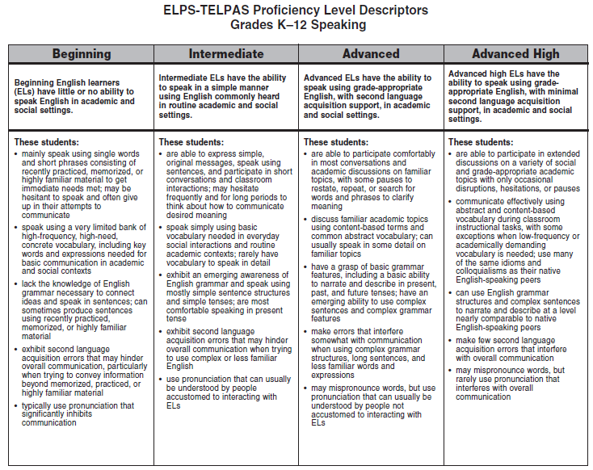
ELPS-TELPAS Proficiency Level Descriptors
Grades K–12 Speaking
Notes:
Review the speaking PLDs and note the overall English communication abilities described in the summary statement for each level.
B little or no English
I simple, commonly heard, routine
A grade-appropriate with second language acquisition support
AH grade-appropriate with minimal second language acquisition support
Examine the main features of each level and note how the descriptors further define the summary statements and show the continuum of English language development across the proficiency levels. The focus of each descriptor is shown below.
1st descriptor: discourse type and length; fluency
2nd descriptor: vocabulary
3rd descriptor: grammar structures
4th descriptor: accuracy
5th descriptor: pronunciation
Beginning vs. Intermediate. Be careful not to conclude that beginners use only single words and phrases to communicate and that students who occasionally produce sentences have reached the intermediate level. Before reaching the intermediate level, beginners will speak in sentences at times, but the sentences will be based primarily on recently practiced, memorized, or highly familiar/formulaic material. Students reach the intermediate level when sentence-length speech is no longer primarily based on recently practiced, memorized, or highly familiar/formulaic material. Students at the intermediate level can use their growing bank of English vocabulary and emerging awareness of basic grammar features to recombine learned elements and “create” with the language in order to speak simply in routine academic/social contexts.
Students Near Border Between Levels. For all language domains, remember to read each proficiency level as a whole to determine the proficiency level at which the student performs most consistently. Remember that students “peak” into the next level before performing most consistently at the new level. Likewise, students who have recently reached a new level may occasionally “spike down” to the level below and not perform entirely consistently at the new level. For students near the border between two levels, determine the level at which the student performs most consistently overall. To do this, step back and read both proficiency levels from top to bottom, making sure to go back and review the summary statement for each level.

Slide 22
Reflect on how well the student speaks English during activities such as:
Cooperative group work
Oral presentations
Informal interactions with peers
Large-group and small-group instructional interactions
One-on-one interviews
Classroom discussions
Articulation of problem-solving strategies
Individual student conferences
Notes:
This list of activities is not exhaustive. Teachers may identify other appropriate activities suited to the grade level(s) taught.
Think about activities that provide good indications of students’ speaking proficiency levels and the differences observed when ELs with different proficiency levels speak during cooperative group work, classroom discussions, oral presentations, etc.
For grades 2-12, teachers use the speaking PLDs for instructional purposes, but not for TELPAS. The domain of speaking is assessed online.

Slide 23
Beginning Speaker (Grade 8)
Tell me about yourself.
My name is An. I am 13 year old from Korea. I hair is long. I tall, thin … have black eye. Favorite color yellow, pink, blue. Favorite food chicken … Favorite sport volleyball and basketball. I like read romance book … I like go my mom supermarket.
Notes:
The following 14 slides present speaking samples. At each proficiency level, the speech of a single student is presented. Each student responds to several speaking tasks that require the use of everyday spoken language as well as academic language.
The speaking samples are not rendered to show pronunciation features. It should be assumed that everything printed was understood by the transcriber. The ellipses indicate “think” pauses and hesitations. In the case of the beginning student, the ellipses may also indicate spots where speech was unintelligible.
These samples are intended to help provide a basic understanding of the speaking PLDs and profile for each level. Remember that when teachers rate the speaking proficiency of their own students, they will have observed the students in a variety of speaking situations, not just on isolated speech samples.
Trainer tip: Trainers may wish to have participants break into small groups, discuss the samples one level at a time, and identify the features from the PLDs that they see represented in the samples.
Beginning features represented in the 4 beginning slides:
Mainly speaks using single words and short phrases
High-frequency, concrete vocabulary
Key words and key expressions for basic communication in academic and social contexts
Lack of ability to connect ideas and speak in sentences
Some sentences and words based on recently practiced, memorized, or highly familiar material
Frequent inaccuracies and communication “breakdown” when trying to convey information beyond linguistic level
Overall: Little or no (functional) ability to speak English in academic and social settings

Slide 24
Beginning Speaker, Example 2
Tell me about your school.
My school name An. I am good student. My project is math. Helper me … interesting. I have new teachers, new friends. My teacher is nice. I happy at school. I read two or three books. That very good.
Notes:
While students at the beginning level may have some ability to express themselves in English (as does this student), they rely on a highly limited bank of vocabulary and only speak in sentences using memorized, highly familiar language. Most of the time they are limited to using isolated words and phrases to convey meaning. These features are demonstrated in each speech sample of this beginning student, who is in the later stages of this level.
Some examples of highly familiar, high-need, memorized language:
My name is…
I am a student.
I am in the --- grade.
I am --- years old.
How are you?
What is your name?
I need [a pencil, paper, eraser, ruler, book…]
I speak [Spanish, Vietnamese…]
I have a [brother, sister, pet, game, car…]
My favorite [color, subject, music, TV show, teacher, sport…] is…
I like to [eat, read, play sports, study…]
I like my [teacher, school, sister, friend, dog…]
I am from…
I live in [city, state, country]

Slide 25
Beginning Speaker, Example 3
Tell me what you have learned about earthquakes.
Earthquakes is important. Is shake Earth … energy very faster. Earthquake came is ten or fifteen minute. People not know come. … People … die. Houses is … fire. Cars go … road cut… one half. … Earthquakes very bad.
Notes:
This beginning student uses some recently learned content vocabulary (earthquakes, energy) and associated vocabulary encountered in the lesson (shake, Earth, die, fire), but the communication breaks down when trying to speak in a connected way about the lesson.

Slide 26

Beginning Speaker, Example 4
What did you learn today about
Christopher Columbus?
Christopher not happy because … no more food. Christopher cry … he do the sail. Queen Elizabeth say Christopher… name important… Christopher went on bowl when is sail … Thirty-one day come Christopher … America.
Notes:
Similar to the previous sample, this student uses some recently learned and highly familiar vocabulary but experiences a communication breakdown when trying to talk about today’s lesson on Christopher Columbus.

Slide 27
Intermediate Speaker (Grade 5)
Tell me about yourself and your family.
My name is Lorenzo. I have two sisters. The name of my sister are Marisa and Ariana. I have my mother and father. I am the baby of family. Now later my mom her … other baby 7 months. I want boy because for play video games. I have a cat. The name is Michi and play of running in the house. My colored favorite is black because my friend he weared all black. I like everybody but one girl. When I grow, I want capitán of army. The army is good for me because I want fly over the state.
Notes:
Intermediate features represented in the 4 intermediate slides:
General ability to speak in sentences
Mostly short, simple sentences
Basic vocabulary needed in everyday interactions
Emerging awareness of basic grammar features
Ability to recombine learned words and phrases to “create” simple, original messages
Speak best in present tense
Overall: Ability to speak in a simple manner using commonly heard English
Speaking sample on this slide:
Second language acquisition inaccuracies increase when the student tries to use complex or less familiar English (now later my mom her … other baby 7 months, the name is --- and play of running in the house).

Slide 28
Intermediate Speaker, Example 2
Tell me about a place where you used to live.
I born in Puerto Rico. Close my house is a river. The name is a arroyo. I go swimming to river with my cousin and friends for 3 hours. After, everybody go to house. In the morning I go to school at 7:30. This is what I make every day.
Notes:
Speaking sample on this slide:
Although telling about where he used to live requires past tense, the student uses the present tense.
Primary language feature: “This is what I make (do) every day” may not be understood by people unaccustomed to Spanish-speaking English language learners.

Slide 29
Intermediate Speaker, Example 3
Tell me what you see in this picture.
The man hunting ducks with rifle. He has hat up on the hair and has jacket of square black and white. The man looks the duck what is swimming in a lake. The others duck is flying. The ducks looking the man with gun. The ducks on the lake said, “No, no kill my family. Please no, no, no.”
Notes:
Speaking sample on this slide:
Primary language and second language acquisition features are frequent (hat up on the hair, jacket of square black and white, the man looks the duck what is swimming).

Slide 30
Intermediate Speaker, Example 4
Tell me about the rock cycle you have drawn.
The magma has 1000º. Is very hot. When the volcano … erosion, the magma is go outside … and the name is lava with rocks. The lava and the rocks called igneous rock. After … the earth is erosion. Also after … phase … then also the period sedimentary rock. When continue, pressure and heat is when the earth … water and ice pressure the rocks…
Notes:
Speaking sample on this slide:
This speaking task requires the ability to explain the rock cycle, which requires the use of more complex language structures and specific, less familiar academic vocabulary.
The student is able to speak using some of the academic vocabulary he has been learning. However, the student pauses frequently and has more difficulty communicating than in the previous slides due to the increased language demands.
Limited English vocabulary and language structures greatly affect the student’s ability to connect ideas and explain this complex process. Overall communication is hindered.

Slide 31
Advanced Speaker (Grade 2)
How are you and your friend alike and different?
My friend is tall and I am short. I have long hair and she has short hair. I have curly hair and she has thin hair. My tooth fell but hers didn’t … I have one bracelets but she has much more. I bring a sweater to school but she does not bring one. I don’t collect stickers but she does.
We have alike because we are girls and have brown eyes. We both like to play a lot. Both have the same friends. We always come to school and always bring our homework. That’s how we are different and alike.
Notes:
Advanced features represented in the 3 advanced slides:
Able to describe in some detail using basic English grammar structures
Able to narrate in basic present, past, and future tenses in some detail
Have vocabulary to speak comfortably and fluidly on familiar, everyday topics
Overall: Ability to speak using grade-appropriate English, with second language acquisition support
Speaking sample on this slide:
The student has grammar structures necessary to make comparisons (My tooth fell but hers didn’t, I don’t collect stickers, but she does, We both like to play a lot).
The student makes minor second language acquisition errors that don’t interfere with communication (My tooth fell, I have one bracelets).

Slide 32
Advanced Speaker, Example 2
Tell me something you did that was fun.
This weekend it was raining and my cousins came at my house. We couldn’t do nothing. My cousin told me, “Ask your mom if we can play in the rain and in the mud.” I went and ask my mom and she said yes but not with that clothes, so I changed my clothes and my mom looked for old clothes for my cousins. Outside was wet and slippery. First we got on my trampoline. We were slipping a lot. Then we got down and were playing with the mud. My cousin drop me on the mud and I said, “Help me up.” He helped me, then I drop him. He said that felt so good and we were laughing…
Notes:
Speaking sample on this slide:
The student is able to speak comfortably about a past event on a familiar topic.
As compared to the intermediate level, vocabulary is progressing from general/basic to more specific/descriptive (mud, slippery, trampoline, slipping).
The student shows an emerging ability to use complex and longer sentences.
Errors occur when attempting to describe using less familiar language (“drop me on the mud” lacks clarity).

Slide 33
Advanced Speaker, Example 3
What have you learned about tepees?
The tepee is a little house that is made of bricks, and it has like brown paper around … but it is the buffalo skin. The Native Americans live in the tepee. They kill the buffalo and use the skin to make clothes … and more things. The Native Americans have pictures around the buffalo skin. The Native Americans have to live just with two beds. Their beds are made of buffalo skin and are not the same like our beds.
Notes:
Speaking sample on this slide:
The student uses content-based language to talk about a familiar academic lesson.
This sample includes less detail than the previous two, and the student shows less comfort due to the academic and linguistic demands.

Slide 34
Advanced High Speaker (Grade 6)
Tell what you have learned about dinosaurs.
Most male dinosaurs mostly ate other dinosaurs to feed the female dinosaurs. I learned that their babies didn’t have to learn how to walk. This is a difference of other baby animals. Most flying dinosaurs got food in the water and ate only fish. They dive down in the water and then went back up. Most female dinosaurs picked some leaves to keep them warm over the night. The same as most animals, they got on top of their eggs so the eggs can stay warm and hatch faster. They had to hatch fast because other animals will eat them. That is why most female dinosaurs stayed most of their time on top of their eggs. Dinosaurs lived good until the humans came and started killing them. Now scientist find skeletons....
Notes:
Advanced high features represented in the 3 advanced high slides:
Able to participate in extended discussions on a variety of social and grade-appropriate academic topics
Communicate effectively using abstract and content-based vocabulary
Use many of the same idioms and colloquialisms as native English-speaking peers
Use complex grammar structures and complex sentences to narrate and describe
Minor (second language) linguistic errors
Overall: Ability to speak using grade-appropriate English, with minimal second language acquisition support
Speaking sample on this slide:
This student is able to effectively communicate what he understood about dinosaurs in class, using appropriate content-based vocabulary (female, male, hatch, humans, skeletons).
The student is able to use long and complex sentences smoothly in explaining academic material.
Minor errors in grammar and tenses do not interfere with overall communication.

Slide 35
Advanced High Speaker, Example 2
Tell me about something that was difficult for you.
Well, I have plenty of problems to get up in the morning really early…Then when I go to school I have reading for my first period, but reading is the only subject I don’t get. I don’t get it because of the coding and going back and finding the answers. It takes a long time to read the whole story three times. The only thing I scored low on the test last year was on the reading. I got a 75 because I read it one time and I got an answer but I read it two more times and I get two more different answers. I couldn’t decide what answer to pick. That happened in almost all the stories. But I’m learning more about reading and now I am getting high scores. I hope I get a better grade than what I got last year.
Notes:
Speaking sample on this slide:
The student elaborates with ease about a common school-related experience (having difficulty reading and taking reading tests).
The student uses idioms and colloquialisms (I don’t get it, I scored low on, I am getting high scores) characteristic of native-English speaking peers.

Slide 36
Advanced High Speaker, Example 3
Tell me what you think of the school rules.
Well, at our school we have a lot of rules. Most rules are not fair. For example, people run to the lunch line because it gets full really fast. Some people come out of the restroom with their shirts tucked out, and if a teacher sees you, you have to do jump squads. Well, sometimes students are uncomfortable having their shirts tucked. Also, you have to watch yourself because if you get 16 tallies you won’t go on a field trip. If you get that much tallies, you can get a detention. If you get a referral, you don’t get to go on the field trip for the nine weeks. If you get in ISS, you have to sit and just do work. Most people like to get that because they don’t want to go to class and do homework. Some people think it is fun but it’s not.
Notes:
Speaking sample on this slide:
The student is able to comfortably and fluidly express and explain his views about whether certain rules are fair.
Unnatural phrasing and linguistic errors (shirts tucked out, jump squads, much tallies) are minor and don’t interfere with communication.

Slide 37
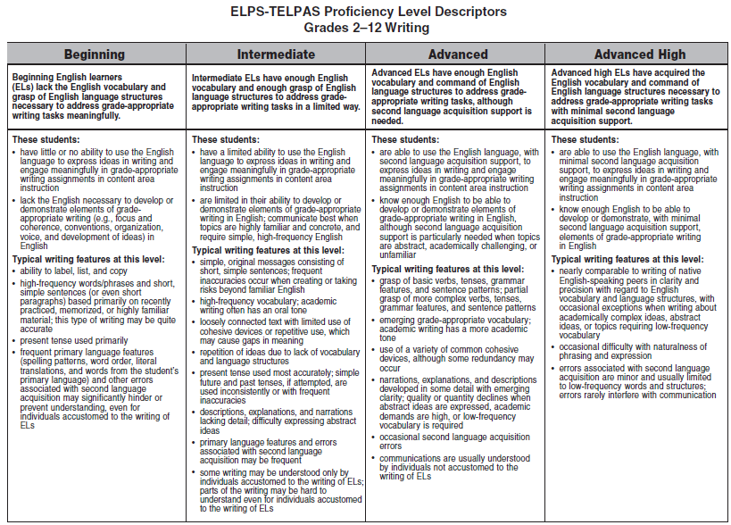
ELPS-TELPAS Proficiency Level Descriptors
Grades 2–12 Writing
Notes:
Review the grades 2–12 writing PLDs and note the overall English proficiency described in each summary statement.
B lack vocabulary and grasp of language structures to address grade-
appropriate writing tasks
I enough vocabulary and grasp of language structures to address grade-
appropriate writing tasks in a limited way
A enough vocabulary and command of language structures to address grade-
appropriate writing tasks, but need second language acquisition support
AH vocabulary acquisition and command of language structures to address
grade-appropriate writing tasks with minimal second language acquisition support
Afterward, examine the main features of each level, and note how the descriptors further define the summary statements and show the continuum of English language development across the proficiency levels. The top two descriptors illustrate the following across the levels:
1st descriptor: ability to use English to express ideas in writing and engage meaningfully in grade-appropriate writing assignments in content area instruction
2nd descriptor: ability to use English to develop or demonstrate elements of grade-appropriate writing in English (e.g., focus and coherence, conventions, organization, voice, and development of ideas)
Teachers need to understand the grade-appropriate writing expectations for the grade levels they are rating. Writing expectations for grade 2 are very different from writing expectations for grade 6 or grade 12.

Slide 38
Writing in Grades 2–12
Remember that the writing ratings of students in grades 2–12 are based on collections of their writing from a variety of content areas.

Slide 39
Writing and Speaking
Remember that incorporating appropriate writing and speaking activities in subject matter instruction helps ELs internalize new English vocabulary and language structures. This helps them –
  improve their command of academic English and
  learn the content taught in their classes.

Slide 40
Writing in Content Areas
Sample ELPS Student Expectations
Narrate, describe, and explain with increasing specificity and detail to fulfill content area writing needs as more English is acquired (c)(5)(G)
In science, this expectation can be addressed through writing assignments in which students, for example, observe, describe, and compare physical properties.
Write using newly acquired basic vocabulary and content-based
grade-level vocabulary (c)(5)(B)
In math, this expectation can be addressed by having students, for example, write about the shapes they are studying and name items at home that are the same shapes.

Slide 41
STAAR Writing vs. TELPAS Writing
STAAR measures how well students compose, revise, and edit texts as required by the TEKS language arts standards. STAAR measures the ability to compose texts with clear, controlling ideas, coherent organization, sufficient development, and appropriate word choice, style, and mechanics.
TELPAS measures how well ELs are able to use English to express their ideas in order to learn the writing skills above and fulfill grade-appropriate writing assignments in all their classes.
Notes:
Teachers more familiar with language arts writing standards than English language proficiency writing standards should review this slide and its notes carefully.
TELPAS does not measure whether students have attained a particular level of academic writing achievement. STAAR measures this.
Do not attempt to equate the advanced high level of English language proficiency with a particular STAAR written composition score or with passing the STAAR writing/ELA test. Neither the STAAR writing rubric nor a list of TEKS writing skills should be used in the TELPAS holistic rating process. To avoid an inappropriate focus on writing achievement, only the TELPAS writing rubrics are permitted to be used.
In cases where an advanced high EL is not successful on a language arts writing assessment, teachers and parents know that it is not for reasons associated with an insufficient ability to express ideas or written information in English. Advanced high ELs who do not pass language arts writing tests typically lack the same writing skills as native speakers of English who don’t pass – that is, they may have weak English conventions; their writing may not be organized; they may not develop and link their ideas in a clear way, etc. Advanced high ELs who are weak in these areas do not need carefully targeted support in second language acquisition; they need the same type of carefully targeted writing instruction as struggling native English speakers.

Slide 42
Introductory Resources for Writing
Several resources support introductory training for this domain:
  Grades 2–12 Writing Collection Overview PowerPoint
  Explains how to assemble writing collections that portray the overall English language proficiency of ELs
  Annotated Examples of Student Writing
  6 writing collections representing a variety of grade levels and English language proficiency levels; each collection includes detailed rating annotations
  TELPAS and TELPAS Alternate Educator Guide
  Contains several annotated writing samples for grades 2-12
  All resources available on TEA’s TELPAS Resources webpage
  Spring web-based TELPAS rater training provides in-depth practice.

Slide 43
Disclaimer
These slides have been prepared by the Student Assessment Division of the Texas Education Agency. You are encouraged to use them for local training.
If any of the slides are changed for local use, please hide or remove any TEA logos, headers, or footers. (You may need to edit the Master slide.)

